Slide 1



Inequality Across Cohorts
Louis Chauvel
University of Luxembourg
louis.chauvel@uni.lu
http://www.louischauvel.org
Measuring, comparing and understanding inequalities between and within social generations:
the age-period-cohort toolbox with LIS
http://www.louischauvel.org/LIS_workshop2022_1.pptx

Slide 2
4(or 3) PARTS
1- Theory of Cohort inequalities
2- Methods for Age Period Cohort
3- Welfare regimes & international comparisons with the LIS
4- An APC approach to gender inequality in 12 countries
Download these slides here
http://www.louischauvel.org/LIS_workshop2022_1.pptx
Notes:
Louis

Slide 3

Louis Chauvel
Pr Dr at University of Luxembourg
louis.chauvel@uni.lu
http://www.louischauvel.org
inequality across birth cohorts
PART 1:
Theory of Cohort Divergences
IRSEI
Institute for Research
on Socio-Economic
Inequality

Slide 4
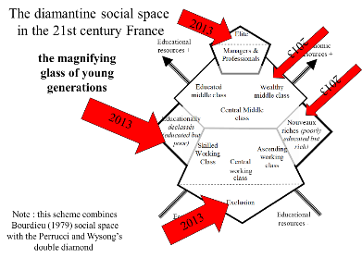
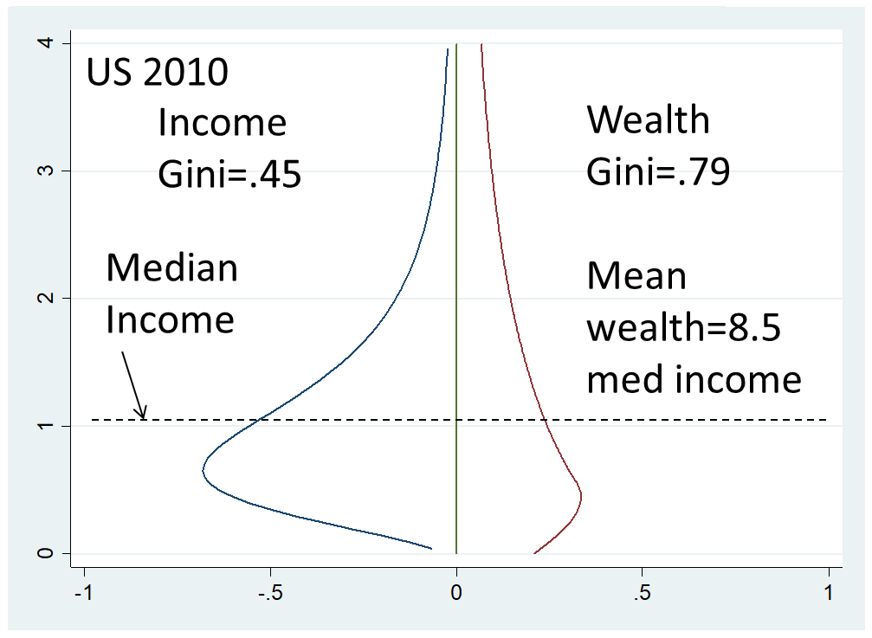
www.louischauvel.org
Extreme inequalities & wealth distributions | Middle class dynamics & class structures
Models of comparative socio historical change | Generational/Cohort change

Slide 5





Slide 6
For economists
=> How the Nobel came to Angus Deaton ?
(or at least it did not ruin his odds to earn it…)
https://www.nber.org/papers/w4330
But now much newer technologies …

Slide 7




  1. From theory to datacrunching:
  Social generations and cohort analysis
  Theory of social generations (Karl Mannheim)
  1968 gap of generations (Margaret Mead)
  Demographic metabolism (Norman Ryder)
  The methodology of APC analysis (Yang Yang)
  Examples:
  * suicide in France
  * consumption in China
  * political participation
  * etc. , etc. , etc.
Karl Mannheim
1893-1947
Margaret Mead
1901-1978
Norman Ryder
1923-2010
Yang Yang
1970?-
www.louischauvel.org/ryder2090964.pdf

Slide 8

  Important references
  www.louischauvel.org/TheMannheim.pdf
  www.louischauvel.org/TheMead.pdf
  www.louischauvel.org/TheRyder.pdf
  http://davidcard.berkeley.edu/papers/vietnam-war-college.pdf
  www.louischauvel.org/TheYANGASR2008.pdf
http://www.louischauvel.org/frenchpolcultsoc.pdf
Margaret Mead
1901-1978

Slide 9
    Theory of generations Karl Mannheim (1928)
  New generations emerge from youth when
  cultural models of socialization are disrupted
  (post first world war Germany)
    3
    Norman Ryder (1965)
    “Cohort effect” as a major element of
    “demographic metabolism”
    (see Wolfgang Lutz 2013)
    Margaret Mead (1968)
    « A deep, new, unprecedented, worldwide generation gap »
    (Beijing 1966, Paris May 1968, Berkeley 1968, Prague 1968, etc.)
    In traditional societies (Samoa), social change is slow:
    seniors control knowledge and power.
    In rapidly changing societies (1968 in the West), future is a priority,
    with techno-scientific progress, seniors’ experience and power are decommissioned,
    and youth lead social change
Lutz, W. 2013. Demographic metabolism: A predictive theory of socioeconomic change. Population and Development Review 38: 283–301.

Slide 10
Socialization versus individual and collective history
    Life course and socialization
    Primary and secondary socialization
    The « transitionnal socialization »
    Long term impact of the « transitionnal socialization » :
    « scar effect »
    History and the constitution of a Generationengeist (spirit of generations) and of a Generationenlage (situation of generation)
Primary socialization Until end of compulsory secondary education (?) | Transitionnal socialization | Secondary socialization « adulthood »
16-18 y.o.
      25-30 y.o.

Slide 11
General question of research on cohort inequalities:
Economic crises and the social integration of new cohorts.
Scarring effects of youth unemployment (Ellwood 1982 / Gangl 2004).
Permanence or resilience of initial trauma and Cumulative advantage/disadvantage (R. Merton 1968, Th. DiPrete 2006)
Or compensation, resilience (Luthar & al. 2000, Bonanno 2004)
Do states differ in how well they could integrate new cohorts or do we see more pronounced insider-outsider dynamics in some countries?
Are some generations sacrificed or do cohorts with a bad start catch up?
Goerres and Vanhuysse (2012: 1)
‘developing an integrated body of knowledge to answer the question of which generations get what, when and how.’
Notes:
Louis

Slide 12

Young generations as victims of social change
France as a crash test
Multidimensional generational fractures in France
Relative(?) socio-economic decline
Overeducation and educational déclassés
Risks of downward mobility
Dyssocialisation
Recomposition of risks of suicide
Out of the political arena
Extreme frustrations and consequences
See➔

Slide 13
Louis Chauvel
Pr Dr at University of Luxembourg
louis.chauvel@uni.lu
http://www.louischauvel.org
inequality across birth cohorts
PART 2:
APC Methods (introduction)
IRSEI
Institute for Research
on Socio-Economic
Inequality

Slide 14
Methodology I : the base ➔ A = P – C
    Method : Lexis diagram (1872)
Age
Isochron
Cohort born
in 1968
c. 1918
1948
80
c. 1978
60
40
20
Age 20
0
1890
1910
1930
1950
1970
1990
2010
2030
Period
BUT ! How to distinguish durable scarring effects and fads ???
Hysteresis = stability versus Resilience = resorption of scars

Slide 15
    Method : Lexis diagram (1872)
Age
Isochron
en 1968
c. 1918
Cohort born
1948
80
c. 1978
60
c. 2008
40
20
Age 20
0
1890
1910
1930
1950
1970
1990
2010
2030
Period

Slide 16
    Method : Lexis diagram (1872)
Age
Isochron
en 1968
c. 1918
Cohort born
1948
80
c. 1978
60
Sacrificed gen
Silent gen
WWII gen
Boomers
c. 2008
40
Xgen
Zgen
Ygen
20
Age 20
0
1890
1910
1930
1950
1970
1990
2010
2030
Period

Slide 17
Differences between Gens
What They Say in Marketing…
Notes:
Check slide to see if this is blurry and whether we need to make a new chart to make it clean

Slide 18
Differences between Gens
What We Do In STATA …
apc syntax in general: ssc install apcd
apcd [dep var] [control vars] [if] [weight], age(var) period(var) [glm ptions]
All glm options including
familyname Description
--------------------------------------------------
gaussian Gaussian (normal)
igaussian inverse Gaussian
poisson Poisson
etc
--------------------------------------------------
linkname Description
--------------------------------------------------
identity identity
log log
logit logit
probit probit
etc
--------------------------------------------------
18

Slide 19
SEE THE STORY IN:
Alair MacLean and Meredith Kleykamp. 2016. “Income Inequality and the Veteran Experience.”
Annals of the American Academy of Political and Social Science 663:99-116.
A STATA example on Veterans
(CPS extracts ipums) 1965-2015
N=322,243
use "http://www.louischauvel.org/apcgoex.dta", clear
* race / 1=caucasian AA=2
* a5 / age
* y5 / year
* labincome / medianized labor personal income
* pweight / sampling weight
* vet / 1=veteran 0=no veteran satus
* ED / level of education 6=drop out 7=ged 8=comunity coll ... 11=Ba 12=Ma+
* female / male=0 female = 1
* lnlab / ln of labincome
keep if fem==0 & a5<65
gen ba=ED==11 | ED==12
ssc install apcd
ssc install apcgo
preserve
collapse vet [w=pwei], by(a5 y5)
su vet
twoway contour vet a5 y5 , heatmap scolor(red) ecolor(blue) ccuts(.05(.05).85 ) aspectratio(.65) scale(.6)
restore
* what is the share of veterans in a cohort? (% points)>
apctlag vet [w=pwei], age(a5) period(y5)
preserve
*retrieve the matrix coefficients for graphics
* many tricks ahead...
mat a=e(b)
mat A=a'
clear
svmat A
gen c5=_n*5+1905
keep if c5<1990
twoway (line A c5) , legend(off)
restore
/*
* what is the share of veterans in a cohort? (logit coeff)>
apctlag vet [w=pwei], age(a5) period(y5) f(bin) l(logit)
* what is the share of BA owners in a cohort? (% points) >
apctlag ba [w=pwei], age(a5) period(y5)
* what is the share of BA owners in a cohort?>
apctlag ba [w=pwei], age(a5) period(y5) f(bin) l(logit)
* how the veteran premium changed?
apcgo lnlab [w=pwei], gap(vet) age(a5) period(y5)
* what is the role of education in the veteran premium change?
xi: apcgo lnlab i.ED if fem==0 [w=pwei], gap(vet) age(a5) period(y5) relax
* with bootstrap confidence intervals (time consuming ! => rep(10) is minimalist but you can change...)
* apcgo lnlab [w=pwei], gap(vet) age(a5) period(y5) rep(10)

Slide 20
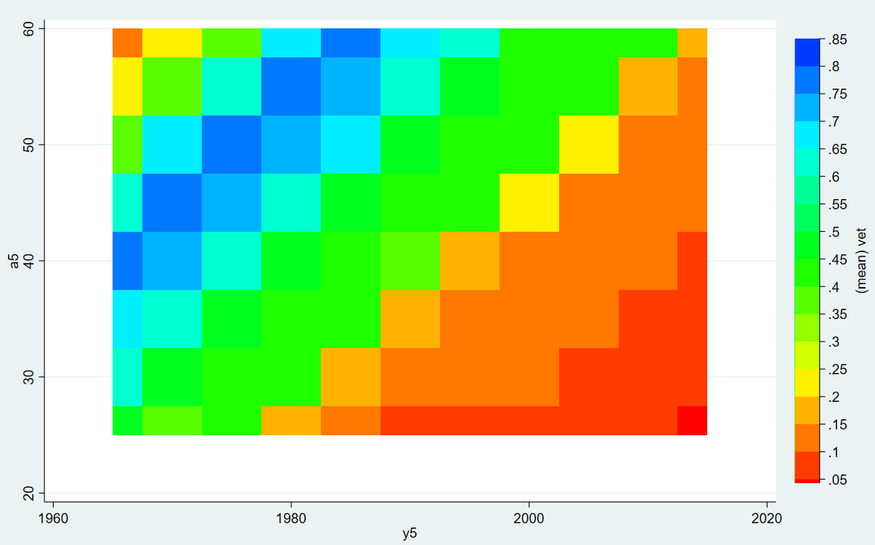
1965-2015
Ex: U.S. veterans in % of the male population (CPS ipums)
Cohort
1965 etc.
=?
Cohort 1905
=?
Cohort 1925
=WWII
Cohort 1945
= Vietnam W
Age
Period

Slide 21
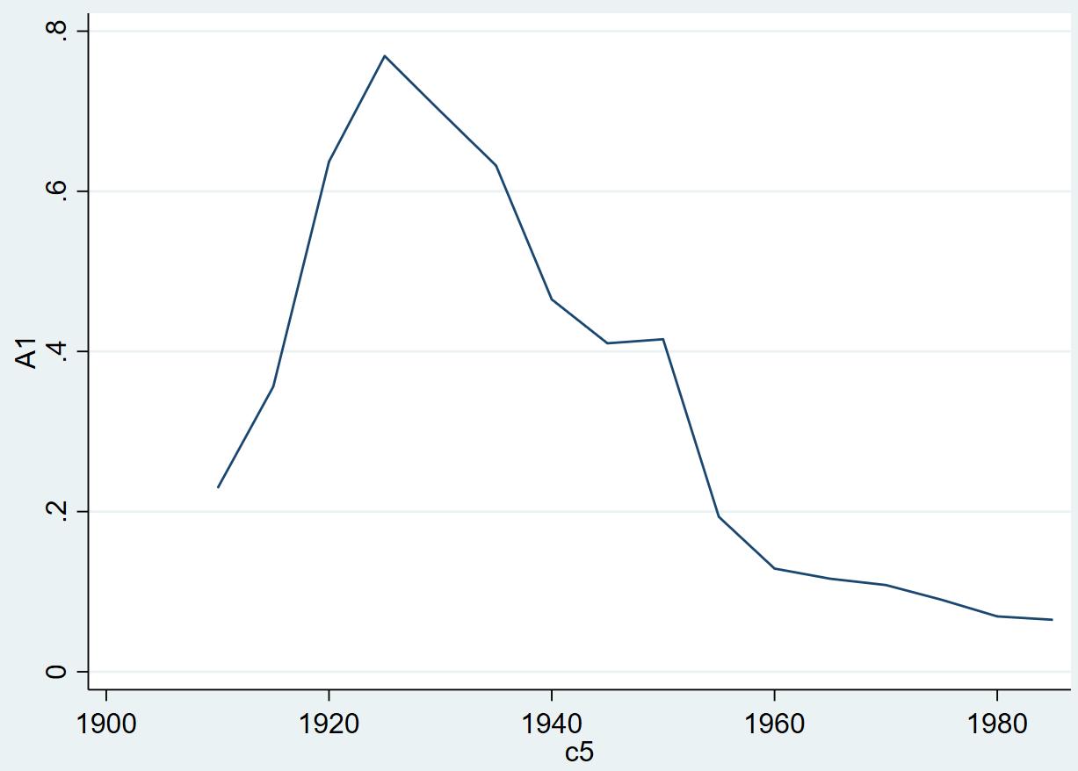
Ex: Veterans as % of the male population (CPS ipums)
APCTLAG model
1965-2015
Cohort 1965
etc. =?
Cohort
Cohort 1905
=?
Cohort 1925
=WWII
Cohort 1945
= Vietnam W

Slide 22
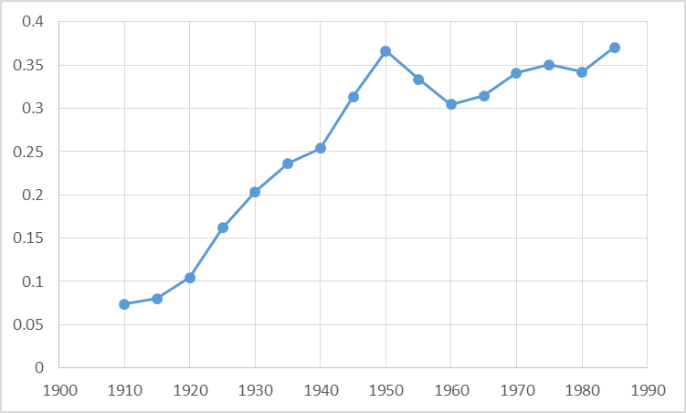

1965-2015
Ex: BA owners % of the male population (CPS ipums)
APCTLAG model
Skyrocketing
tuition and fees
Cohort 1948
"Going to College to Avoid the Draft: The Unintended Legacy of the Vietnam War." (David Card, Thomas Lemieux), American Economic Review 91, May 2001.
Cohort 1925
=GI bill of rights
Cohort

Slide 23
1965-2015
Ex: Veterans wage premium (diff of log)
APCGO model (GO=Gap Oaxaca)
WWII veterans
premium >30%
Cohort 1955
Premium<0
SEE THE STORY IN:
Alair MacLean and Meredith Kleykamp. 2016. “Income Inequality and the Veteran Experience.” Annals of the American Academy of Political and Social Science 663:99-116.

Slide 24
Statistical background: Age Period Cohort models
Separate the effects of age, period of measurement and cohort.
Problematic colinearity:
cohort (date of birth) = period (date of measurement) - age
(Ryder 1965, Mason et al. 1973, Mason / Fienberg 1985, Mason / Smith 1985,
Yang Yang et al. 2006 2008, Smith 2008, Pampel 2012)
Notes:
Louis

Slide 25


Remember Whelpton and Frost
APC literature: Gospels & Bibles 1970-1990s
MASON K. O., MASON W. M., WINSBOROUGH H. H., POOLE K., 1973, “Some methodological issues in cohort analysis of archival data”, American sociological review, 38, pp. 242-258.
GLENN N. D., 1976, “Cohort analysts’ futile quest : statistical attempts to separate age, period, and cohort effects”, American sociological review, 41, pp. 900-905.
Adams, J. 1978. “Sequential Strategies and the Separation of Age, Cohort, and Time-of-Measurement Contributions to Developmental Data.” Psychological Bulletin 85: 1309-16.
HASTINGS D. W., BERRY L. G., 1979, Cohort analysis : a collection of interdisciplinary readings, Oxford (Ohio), Scripps Foundation for Research in Population Problems.
Rodgers, W.L. 1982. “Estimable Functions of Age, Period, and Cohort Effects.” American Sociological Review 47:774-87.
Holford, T.R. 1983. “The Estimation of Age, Period, and Cohort Effects for Vital Rates.” Biometrics 39:311-24.
Mason W.M. and H.L. Smith. 1985. “Age-Period-Cohort Analysis and the Study of Deaths from Pulmonary Tuberculosis.” Pp.151-228 in Cohort Analysis in Social Research: Beyond the Identification Problem, edited by W.M. Mason and S.E. Fienberg. New York: Springer-Verlag.
MASON W. M., FIENBERG S. E., 1985, Cohort analysis in social research : beyond the identification problem, Berlin, Springer Verlag.
Clayton, D. and E. Schifflers. 1987a. “Models for Temporal Variation in Cancer Rates I: Age-Period and Age-Cohort Models.” Statistics in Medicine 6:449-67.
Clayton, D. and E. Schifflers. 1987b. “Models for Temporal Variation in Cancer Rates II: Age-Period-Cohort Models.” Statistics in Medicine 6:468-81.
Hout M. and A.M. Greeley, 1989, “The Cohort Doesn't Hold: Comment on Chaves”, Journal for the Scientific Study of Religion, n. 29, pp.519-524.
WILMOTH J. R., 1990, “Variation in vital rates by age, period, and cohort”, in C. C. Clogg (ed.), Sociological methodology, Oxford, Basil Blackwell, vol. 20, pp. 295-335.
WILMOTH J. R., 2001, “Les modèles âge-période-cohorte en démographie”, in G. CASELLI, J. VALLIN, G. WUNSCH (eds.), Démographie : analyse et synthèse. I : La dynamique des populations, Paris, Ined, pp. 379-397.

Slide 26
APC literature 2008-2013
Yang, Y. and Land, K.C. (2008). Age–period–cohort analysis of repeated cross-section surveys. Fixed or random effects? Sociological Methods & Research 36(3):297–326.
Smith, H.L. (2008). “Advances in Age-Period-Cohort Analysis.” Sociological Methods & Research 36-3:287-96.
Yang Y., Schulhofer-Wohl, S., Fu, W. and Land, K. (2008). “The Intrinsic Estimator for Age-Period-Cohort Analysis: What It is and How to Use it?” American Journal of Sociology, 113:1697-1736.
O’Brien, R.M. 2011a. “Constrained Estimators and Age-Period-Cohort Models.” Sociological Methods & Research 40:419-52.
Hui Zheng, Yang Yang and Kenneth C. Land, 2011, Variance Function Regression in Hierarchical Age-Period-Cohort Models: Applications to the Study of Self-Reported Health, Am Sociol Rev. 2011 December; 76(6): 955–983.
Wilson, J.A., Zozula, C. and Gove, W.R. (2011). Age, Period, Cohort and Educational Attainment: The Importance of Considering Gender. Social Science Research 40:136-49.
Pampel, F.C. and Hunter, L.M. (2012). Cohort Change, Diffusion, and Support for Environmental Spending in the United States. American journal of sociology 118(2):420-448.
Campbell Colin, Jessica Pearlman (2013), Period effects, cohort effects, and the narrowing gender wage gap, Social Science Research, Volume 42, Issue 6, p.1693–1711
Yang Y. and Land, K.C. (2013), Age-period-cohort analysis. New models, methods, and empirical applications. CRC Press, Taylor & Francis Group, Boka Raton, FL
Fienberg, S. E. (2013). Cohort analysis’ unholy quest: A discussion. Demography, 50, 1981–1984.
Luo, L. (2013). Assessing Validity and Application Scope of the Intrinsic Estimator Approach to the Age-Period-Cohort Problem. Demography 50(6):1945-67.
Dassonneville, R. (2013). Questioning generational replacement. An age, period and cohort analysis of electoral volatility in the Netherlands, 1971–2010. Electoral Studies 32(1):37-47

Slide 27
APC literature (2013-2015)
Lutz, W. (2013). Demographic metabolism: A predictive theory of socioeconomic change. Popul. Dev. Rev. 38, 283–301.
Grasso, M.T. (2014). Age, Period and Cohort Analysis in a Comparative Context: Political Generations and Political Participation Repertoires in Western Europe. Electoral Studies, 33:63–76.
Chancel L. (2014). Are Younger Generations Higher Carbon Emitters than their Elders?: Inequalities, Generations and CO2 Emissions in France and in the USA. Ecological Economics, 100:195–207.
Phillips, J. A. (2014). A changing epidemiology of suicide? The influence of birth cohorts on suicide rates in the United States. Social Science & Medicine, 114, 151-160.
Schwadel, P. and Garneau, C. R. H. (2014), An Age–Period–Cohort Analysis of Political Tolerance in the United States. The Sociological Quarterly, 55: 421–452
Chauvel, L. and Schröder M., (2014). Generational inequalities and welfare regimes. Social forces 92 (4):1259-1283.
Chauvel, L. and Smits F.. (2015). The endless baby-boomer generation: Cohort differences in participation in political discussions in nine European countries in the period 1976-2008. In: European Societies.
Reither, E. N., Masters, R. K., Yang, Y. C., Powers, D. A., Zheng, H., & Land, K. C. (2015). Should age-period-cohort studies return to the methodologies of the 1970s? Social Science & Medicine.
Harper S. Invited commentary: A-P-C . . . It’s easy as 1-2-3! Am J Epidemiol. 2015 online publication
O’Brien RM, 2015, Model Misspecification when Eliminating a Factor in Age-Period-Cohort Models, ASA 2015 Chicago mimeo.

Slide 28
APC literature (2015-2017)
Chauvel, L. and M. Schröder. 2015. The impact of cohort membership on disposable incomes in West Germany, France, and the United States. European Sociological Review, 31:298-311.
Reither, E. N., Masters, R. K., Yang, Y. C., Powers, D. A., Zheng, H., & Land, K. C. (2015). Should age-period-cohort studies return to the methodologies of the 1970s? Social Science & Medicine.
Harper S. Invited commentary: A-P-C . . . It’s easy as 1-2-3! Am J Epidemiol. 2015 online publication
Lindahl-Jacobsen, R., Rau, R., Jeune, B., Canudas-Romo, V., Lenart, A., Christensen, K., & Vaupel, J. W. (2016). Rise, stagnation, and rise of Danish women’s life expectancy. Proceedings of the National Academy of Sciences, 113(15), 4015-4020.
Chauvel, L., Leist, A. K., & Smith, H. L. (2016). Cohort factors impinging on suicide rates in the United States, 1990-2010. Annual Meeting of the Population Association of America, March 31 - April 2, 2016, Washington, DC. Full paper available at http://orbilu.uni.lu/handle/10993/25339.
Chauvel L, Leist AK, Ponomarenko V (2016) Testing Persistence of Cohort Effects in the Epidemiology of Suicide: an Age-Period-Cohort Hysteresis Model.
PLoS ONE 11(7): e0158538. doi:10.1371/journal.pone.0158538
Bell, A. and K. Jones. 2017. The hierarchical age–period–cohort model: Why does it find the results that it finds? Quality & Quantity: 1-17.
Barbosa, Rogério Jerônimo Desigualdade de Rendimentos do Trabalho no Curto e no Longo Prazo: Tendências de Idade, Período e Coorte Dados - Revista de Ciências Sociais, vol. 59, núm. 2, abril-junio, 2016, pp. 385-425
Alair MacLean and Meredith Kleykamp. 2016. “Income Inequality and the Veteran Experience.” Annals of the American Academy of Political and Social Science 663:99-116.

Slide 29
APC literature (2016-2019)
Dorius, Shawn F., Duane F. Alwin, and Julianna Pacheco. 2016. “Twentieth Century Intercohort Trends in Verbal Ability in the United States.” Sociological Science 3:383-412.
Fosse, Ethan, and Christopher Winship. 2016. “Nonparametric Bounds of Age-Period-Cohort Effects.” Unpublished paper last downloaded from https://q-aps.princeton.edu/sites/default/files/q-aps/files/apcbounds_draft.pdf on 31 March 2019.
-----. 2018. “Moore–Penrose Estimators of Age–Period–Cohort Effects: Their Interrelationship and Properties.” Sociological Science 5(14):304-334.
Luo, Liying, and James S. Hodges. 2016. “Block Constraints in Age–Period–Cohort Models with Unequal-width Intervals.” Sociological Methods & Research 45(4):700-726.
O’Brien, Robert M-----. 2015. Age-Period-Cohort Models: Approaches and Analyses with Aggregate Data. Boca Raton, FL: Chapman and Hall/CRC Press.
-----. 2016. “Model Misspecification When Eliminating a Factor in Age-period-cohort Multiple Classification Models.” Pp. 358-372 in Sociological Methodology 2016, edited by Duane F. Alwin. Thousand Oaks, CA: Sage Publishing.
-----. 2018. “Homicide Arrest Rate Trends in the United States: The Contributions of Periods and Cohorts (1965–2015).” Journal of Quantitative Criminology 34(online first).
Vaisey, Stephen, and Omar Lizardo. 2016. “Cultural Fragmentation or Acquired Dispositions? A New Approach to Accounting for Patterns of Cultural Change.” Socius: Sociological Research for a Dynamic World 2:1-15.
Yang, Guobin. 2016. The Red Guard Generation and Political Activism in China. New York: Columbia University Press.
Albis Hippolyte d', Badji Ikpidi. Intergenerational inequalities in standards of living in France. In: Economie et Statistique / Economics and Statistics, n°491-492, 2017. Age and generations. pp. 71-92.
Louis Chauvel and Anja Leist, Overweight and obesity of mid-aged cohorts: Increasing burden, increasing educational inequalities, Innovation in Aging, 2018.
Shen, Yinzhi, Shawn Bushway, Lucy Sorenson, and Herbert Smith. 2019. “Locking Up My Generation: Cohort Differences in Prison Sentence Spells over the Life Course.” Poster presented at the Annual Meeting of the Population Association of America, April 2019, Austin, TX.
Eyal Bar-Haim, Louis Chauvel, Anne Hartung , More Necessary and Less Sufficient: An Age-Period-Cohort Approach to Overeducation in Comparative Perspective, in Higher Education, 2019
Karonen, E. and Niemelä, M. (2019), Life Course Perspective on Economic Shocks and Income Inequality Through Age‐Period‐Cohort Analysis: Evidence From Finland. Review of Income and Wealth. doi:10.1111/roiw.12409

Slide 30

APC literature (2020...)
Bell, A. (Ed.). (2020). Age, Period and Cohort Effects: Statistical Analysis and the Identification Problem (1st ed.). Routledge. https://doi.org/10.4324/9780429056819
Emeka, Amon. 2020. Free and clear: national origins and progress toward unencumbered homeownership among post-civil rights era immigrants in the US. Journal of Ethnic & Migration Studies. Dec2020, Vol. 46 Issue 18, p3808-3828. 21p. 1 Color Photograph, 2 Charts, 3 Graphs. DOI: 10.1080/1369183X.2019.1592876.
Castillo‐Carniglia, Alvaro; Rivera‐Aguirre, Ariadne; Calvo, Esteban; Queirolo, Rosario; Keyes, Katherine M.; Cerdá, Magdalena. 2020. Trends in marijuana use in two Latin American countries: an age, period and cohort study. Addiction. Nov2020, Vol. 115 Issue 11, p2089-2097. 9p. 1 Chart, 3 Graphs. DOI: 10.1111/add.15058.
Shen, Yinzhi; Bushway, Shawn D.; Sorensen, Lucy C.; Smith, Herbert L. 2020. Locking up my generation: Cohort differences in prison spells over the life course. Criminology. Nov2020, Vol. 58 Issue 4, p645-677. 33p. DOI: 10.1111/1745-9125.12256.
Liu, Sze Yan; Lim, Sungwoo. 2020. Collective Trauma and Mental Health Hospitalization Rates Among Children in New York State, 1999-2013: Age, Period, and Cohort Effects. Journal of Traumatic Stress. Oct2020, Vol. 33 Issue 5, p824-834. 11p. 2 Charts, 4 Graphs. DOI: 10.1002/jts.22449.
Vogel, Matt; Thompson, Kristina J; Messner, Steven F. 2020. The Enduring Influence of Cohort Characteristics on Race-Specific Homicide Rates. Social Forces. Sep2020, Vol. 99 Issue 1, p1-30. 30p. DOI: 10.1093/sf/soz127.
Shi, Luzi; Lu, Yunmei; Pickett, Justin T. 2020. The public salience of crime, 1960–2014: Age–period–cohort and time–series analyses†. Criminology. Aug2020, Vol. 58 Issue 3, p568-593. 26p. DOI: 10.1111/1745-9125.12248.
Kratz, Fabian; Patzina, Alexander. 2020. Endogenous Selection Bias and Cumulative Inequality over the Life Course: Evidence from Educational Inequality in Subjective Well-Being. European Sociological Review. Jun2020, Vol. 36 Issue 3, p333-350. 18p. 5 Graphs. DOI: 10.1093/esr/jcaa003.
Vallée‐Dubois, Florence; Dassonneville, Ruth; Godbout, Jean‐François. 2020. Educational equalization; Subjective well-being (Psychology); Demographic surveys; Labor supply; Selection bias (Statistics); Labor market research
Nations & Nationalism. Apr2020, Vol. 26 Issue 2, p344-365. 22p. DOI: 10.1111/nana.12378.
Hardy, Melissa; Skirbekk, Vegard; Stonawski, Marcin. 2020. The Religiously Unaffiliated in Germany, 1949–2013: Contrasting Patterns of Social Change in East and West. Sociological Quarterly. Spring2020, Vol. 61 Issue 2, p254-286. 33p. 9 Charts, 1 Graph. DOI: 10.1080/00380253.2019.1593064.
Thammatacharee, Noppakun; Mills, Anne; Nitsch, Dorothea; Lumpaopong, Adisorn. 2020. The changing patterns of access overtime to the renal replacement therapy programme in Thailand. Health Policy & Planning. Feb2020, Vol. 35 Issue 1, p1-6. 6p. DOI: 10.1093/heapol/czz121.
Attell, Brandon K. 2020. Changing Attitudes Toward Euthanasia and Suicide for Terminally Ill Persons, 1977 to 2016: An Age-Period-Cohort Analysis. Omega: Journal of Death & Dying. Feb2020, Vol. 80 Issue 3, p355-379. 25p. 2 Charts, 4 Graphs. DOI: 10.1177/0030222817729612.

Slide 31
APC literature (2020...)
Lu, Yunmei; Luo, Liying. 2021. Cohort Variation in U.S. Violent Crime Patterns from 1960 to 2014: An Age–Period–Cohort-Interaction Approach. Journal of Quantitative Criminology. Dec2021, Vol. 37 Issue 4, p1047-1081. 35p. 7 Charts, 9 Graphs. DOI: 10.1007/s10940-020-09477-3.
Kellerborg, Klas; Wouterse, Bram; Brouwer, Werner; van Baal, Pieter. 2021. Estimating the costs of non-medical consumption in life-years gained for economic evaluations. Social Science & Medicine. Nov2021, Vol. 289, pN.PAG-N.PAG. 1p. DOI: 10.1016/j.socscimed.2021.114414.
Tunalı, İnsan; Kırdar, Murat G.; Dayıoğlu, Meltem. 2021. Down and up the "U" – A synthetic cohort (panel) analysis of female labor force participation in Turkey, 1988–2013. World Development. Oct2021, Vol. 146, pN.PAG-N.PAG. 1p. DOI: 10.1016/j.worlddev.2021.105609.
Twenge, Jean M.; Blake, Andrew B. 2021. Increased Support for Same-sex Marriage in the US: Disentangling Age, Period, and Cohort Effects. Journal of Homosexuality. 2021, Vol. 68 Issue 11, p1774-1784. 11p. 1 Chart, 5 Graphs. DOI: 10.1080/00918369.2019.1705672.
Redding, Stuart; Nicodemo, Catia; Wittenberg, Raphael. 2021. Analysis of trends in emergency and elective hospital admissions and hospital bed days 1997 to 2015. Social Science & Medicine. Jun2021, Vol. 279, pN.PAG-N.PAG. 1p. DOI: 10.1016/j.socscimed.2021.114002.
Tsatsanis, Emmanouil; Lisi, Marco; Freire, André. 2021. The 'Lost Generation' and Its Political Discontents: Age-related Divides in Southern Europe after the Crisis. South European Society & Politics. Jun2021, Vol. 26 Issue 2, p133-151. 19p. DOI: 10.1080/13608746.2021.2032936.
Lisi, Marco; Quaranta, Mario; Real-Dato, José; Tsatsanis, Emmanouil. 2021. Assessing the Impact of Age, Cohort and Period Effects on Partisanship and Support for Mainstream Parties: Evidence from Southern Europe. South European Society & Politics. Jun2021, Vol. 26 Issue 2, p239-270. 32p. DOI: 10.1080/13608746.2021.1965322.
Kaur, Navdep; Keyes, Katherine M.; Hamilton, Ava D.; Chapman, Cath; Livingston, Michael; Slade, Tim; Swift, Wendy. 2021. Trends in cannabis use and attitudes toward legalization and use among Australians from 2001–2016: an age‐period‐cohort analysis. Addiction. May2021, Vol. 116 Issue 5, p1152-1161. 10p. 1 Chart, 6 Graphs. DOI: 10.1111/add.15271.
Santos, Mateus Rennó; Lu, Yunmei; Fairchild, Rachel E. 2021. Age, Period and Cohort Differences Between the Homicide Trends of Canada and the United States. British Journal of Criminology. Mar2021, Vol. 61 Issue 2, p389-413. 25p. DOI: 10.1093/bjc/azaa080.
Vera-Toscano, Esperanza; Meroni, Elena C. 2021. An Age–Period–Cohort Approach to the Incidence and Evolution of Overeducation and Skills Mismatch. Social Indicators Research. Jan2021, Vol. 153 Issue 2, p711-740. 30p. 5 Charts, 7 Graphs. DOI: 10.1007/s11205-020-02514-5.

Slide 32
APC literature (2020...)
Luo, Liying; Hodges, James S. 2022. The Age-Period-Cohort-Interaction Model for Describing and Investigating Inter-cohort Deviations and Intra-cohort Life-course Dynamics. Sociological Methods & Research. Aug2022, Vol. 51 Issue 3, p1164-1210. 47p. DOI: 10.1177/0049124119882451.
Jiang, Anli; Wang, Zhengxu; Zhang, Tony Huiquan. 2022. Radicalizing and Conservatizing: Ageing Effects on Political Trust in Asia, 2001–2016. Social Indicators Research. Jul2022, Vol. 162 Issue 2, p665-681. 17p. 4 Charts, 1 Graph, 1 Map. DOI: 10.1007/s11205-021-02848-8.
Jiang, Junfeng; Wang, Peigang. 2022. Which Generation is More Likely to Participate in Society? A Longitudinal Analysis. Social Indicators Research. Jul2022, Vol. 162 Issue 1, p209-229. 21p. 7 Charts, 4 Graphs. DOI: 10.1007/s11205-021-02830-4.
Ye, Yiwan; Shu, Xiaoling. 2022. Lonely in a Crowd: Cohort Size and Happiness in the United Kingdom. Journal of Happiness Studies. Jun2022, Vol. 23 Issue 5, p2235-2257. 23p. 4 Charts, 1 Graph. DOI: 10.1007/s10902-021-00495-x.
Opazo Breton, Magdalena; Gillespie, Duncan; Pryce, Robert; Bogdanovica, Ilze; Angus, Colin; Hernandez Alava, Monica; Brennan, Alan; Britton, John. 2022. Understanding long‐term trends in smoking in England, 1972–2019: an age–period–cohort approach. Addiction. May2022, Vol. 117 Issue 5, p1392-1403. 12p. 1 Color Photograph, 4 Graphs. DOI: 10.1111/add.15696.
Bramajo, Octavio Nicolas. 2022. An Age-Period-Cohort Approach to Analyse Late-Life Depression Prevalence in Six European Countries, 2004–2016. European Journal of Population. May2022, Vol. 38 Issue 2, p223-245. 23p. DOI: 10.1007/s10680-022-09610-x.
Myck, Michał; Oczkowska, Monika. 2022. Healthier over time? Period effects in health among older Europeans in a step-wise approach to identification. Social Science & Medicine. Mar2022, Vol. 297, pN.PAG-N.PAG. 1p. DOI: 10.1016/j.socscimed.2022.114791.
Langou Lian. 2022. Changing Times, Shifting Attitudes: Explaining Americans' Attitudes Toward Same‐Sex Relations From 1973 to 2018. Sociological Forum. Mar2022, Vol. 37 Issue 1, p269-292. 24p. 2 Charts, 4 Graphs. DOI: 10.1111/socf.12788.
Spelman, William. 2022. Why birth cohorts commit crime at different rates. Social Science Research. Feb2022, Vol. 102, pN.PAG-N.PAG. 1p. DOI: 10.1016/j.ssresearch.2021.102628.
Li, Xiaoguang; Guo, Xiaoxian. 2022. Dynamics of social capital in Urban China, 1999 to 2014: An age-period-cohort analysis. Social Networks. Jan2022, Vol. 68, p394-406. 13p. DOI: 10.1016/j.socnet.2021.10.006.

Slide 33
Our method A: APCD
APCD (detrended): are some cohorts above or below a linear trend of long-run economic growth? Basically, the APCD is a ‘bump detector’.
STATA ssc install apcd
=> available ado file
PLZ see more on www.louischauvel.org/apcdex.htm
Notes:
Louis

Slide 34
Our method B: the larger APC family (with STATA ssc install )
APCD (detrended): are some cohorts above or below a linear trend of long-run economic growth? Basically, the APCD is a ‘bump detector’. ssc install apcd
APCTLAG (trended by cohort once average lagged age effect fitted): which cohort increased or declined. The program is a part of the ssc install apcgo
APCGO (gap / Oaxaca): once controlled by other covariates, did the gap between group 0 and 1 changed. ssc install apcgo
APCH (hystersis) is the cohort apcd effect bump durable (or not) across periods
Refinements to come (faster bootstraps, better controls, simplification, etc.)
Notes:
Louis

Slide 35
Louis Chauvel
Pr Dr at University of Luxembourg
louis.chauvel@uni.lu
http://www.louischauvel.org
inequality across birth cohorts
PART 3:
WELFARE REGIMES
COMPARISONS
IRSEI
Institute for Research
on Socio-Economic
Inequality

Slide 36
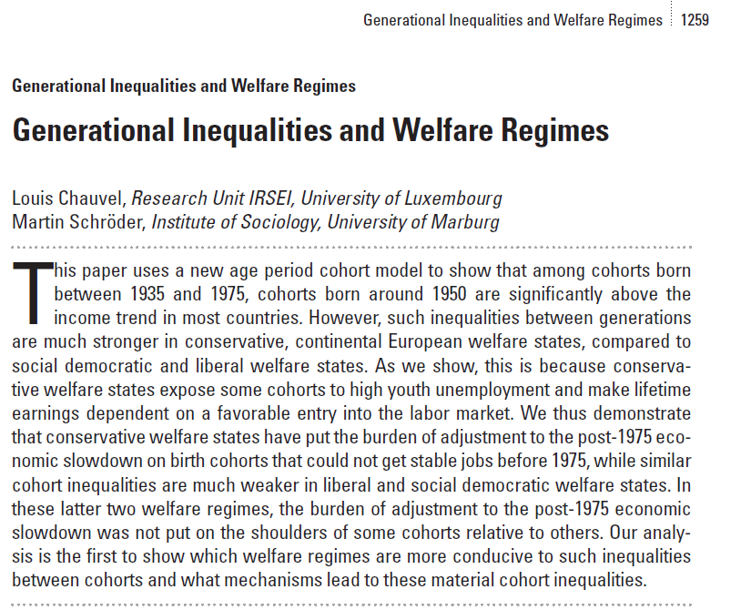

  Backgrounds …
A 17 countries comparison of inter-cohort inequalities
See also : Chauvel, L. and M. Schröder. 2015. The impact of cohort membership on disposable incomes
in West Germany, France, and the United States. European Sociological Review, 31:298-311.

Slide 37
Émile Durkheim (1897),
Le suicide. Étude de sociologie, p.1
Interpreting the French case:
    Esping-Andersen Typology of Welfare states:
    France = “corporatist-conservative” welfare regime, stabilization of social relations
    Protection of insiders (protected male workers) against outsiders
    In case of economic brake :
    « Insiderisation » of insiders, already in the stable labor force
    and « outsiderisation » of new entrants
    In France, young people can wait … decades
    Increasing poverty rates for young people, stable intracohort inequalities
    (after taxes and welfare reallocations)
Emile Durkheim’s Suicide

Slide 38


  Theories of Welfare Regimes
  Decommodification models and welfare regimes
“De-commodification occurs when a service is rendered as a matter of right, and when a person can maintain a livelihood without reliance on the market” (Esping-Anderson, pp. 21-22)
Gosta Esping-Andersen (Danish, born 1947)
Professor @ Universitat Pompeu Fabra (Barcelona).

Slide 39


  Central references
  Pierson Ch. and Castles F.G. (eds) 2006,
  The Welfare State Reader, 2nd ed, Cambridge: Polity Press.
Pierson C., Obinger H., Lewis J., Leibfried S., Castles F.G. (Eds), 2010,
The Oxford Handbook of the Welfare State, Oxford ; Ox Univ Pr.

Slide 40

  Central references
  Schröder, Martin, 2013:
  Integrating Varieties of
  Capitalism and Welfare State Research:
  A Unified Typology of Capitalisms.
  New York: Palgrave.

Slide 41
 | Liberal (=Residual) Theoretical equality of opportunity | Corporatist (=Conservative) Maintaining social order | Social-demo. (=Universalistic) decommodification defamilialistion destartification
Degree / Model of decommodification | Free Market as the central institution | Intermediate level of decommo-dification | Collective social consumption promoted
System of social stratification | Protection of the (good) poor, but stigmatization of “free riders”: Strong economic inequalities but more permeable boundaries between social classes | Solidarity between equals: Intermediate degree of inequality but social boundaries strongly impermeable | Economic, gender, inequality is minimal and strong “fluidity” (net mobility, equality of opportunities & outcomes) between classes
Typical countries | US UK | Germany (France) | Sweden

Slide 42
Three (+1) modalities Esping-Andersen Typology of Welfare states :
    Conservative model (Continental Europe) : FRANCE
    Preservation of (old) social balance, with social insurance excluding unemployed => strong intercohort inequalities and less intracohort inequalities than in the Liberal model
    <Familialistic Model (Mediterranean Europe) : ITALY>
    <Conservative + family and local and clientelistic solidarities>
    Liberal model : (Anglo-saxon world) : US
    Market as a central institution, residual welfare state against market failures
    HL0 : more intracohort inequalities
    HL1 : less intercohort inequality (competition between generations)
    « Social-democrat » Model (Nordic Europe) : DENMARK
    Citizenship and broad participation to discussions and bargaining around social reforms between social groups (gender, generations, etc.) for a long-term development
    HD0 : less intracohort inequalities
    HD1 : residual intercohort inequalities (positive compromise between generations)

Slide 43
4. Data
Dependent variable
We want to explain the living standards of members of different cohorts:
Variable “dhi” (disposable income) from the Luxembourg Income Study.
Logged and equivalized (divided by the square root of household members) and adjusted for inflation: reflects household-equalized real disposable income after taxes and transfers.
Independent variables
Age, Period of measurement, Cohort-membership of respondent (date of birth).
Plus controls for:
education (ISCED code), sex, partner in household, # of children, immigrant-status.
Main interest
How much does the mere date of birth (cohort membership) influence living standards? – in terms of deviation from the linear trend
Notes:
Martin

Slide 44
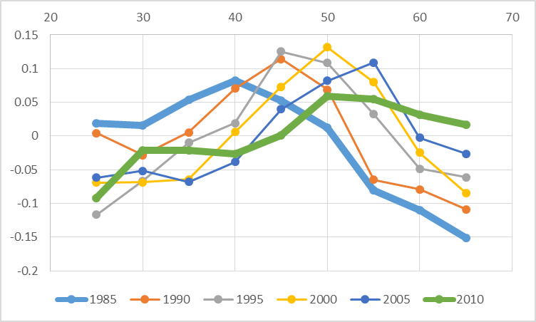
a. Relative(?) socio-economic decline
France
Lis 1985-2010
Log level of living (=disposable income per CU)
by age group (0= year average)
age
1980
2010

Slide 45
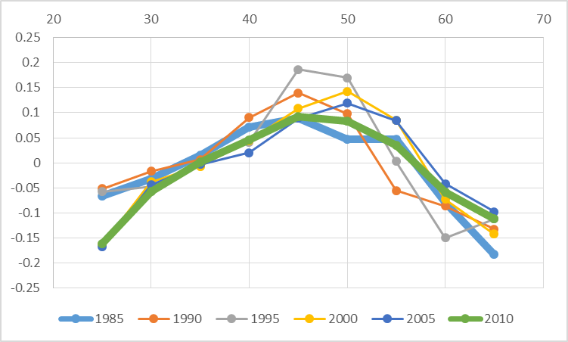
a. Relative(?) socio-economic decline
Germany
Lis 1985-2010
Log level of living (=disposable income per CU)
by age group (0= year average)
age
1980
2010

Slide 46
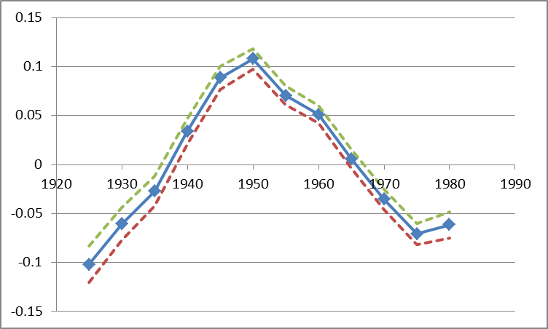
France : APCD (detrended) cohort coefficient of disposable per uc income
cohorts
controls for:
education (ISCED code), sex, partner in household, # of children, immigrant-status.
Luxembourg Income Study microdata – 1980s to 2010s
Notes:
Martin
These figures show: how much different cohorts (people with different dates of birth) are below or above the long-run trend of economic growth, before and after controls are introduced.
Germany: Fortunate cohorts can have a living standards around 8 percent above of what one would expect when every cohort‘s income would have been proportionate with general trends of economic growth. But much of this is due to their better education etc. After this is controlled, only the cohorts born around 1945/50 are about 5 percent above the trend.
France: Fortunate cohort‘s living standard about 10 percent above the trend, unfortunate ones almost 10 percent below it. Even worse after controls are introduced (right side).
US: cohort‘s living standard does not diverge very much from the trend.
But how does this compare when set in relation to overall increases in living standards? APCT

Slide 47
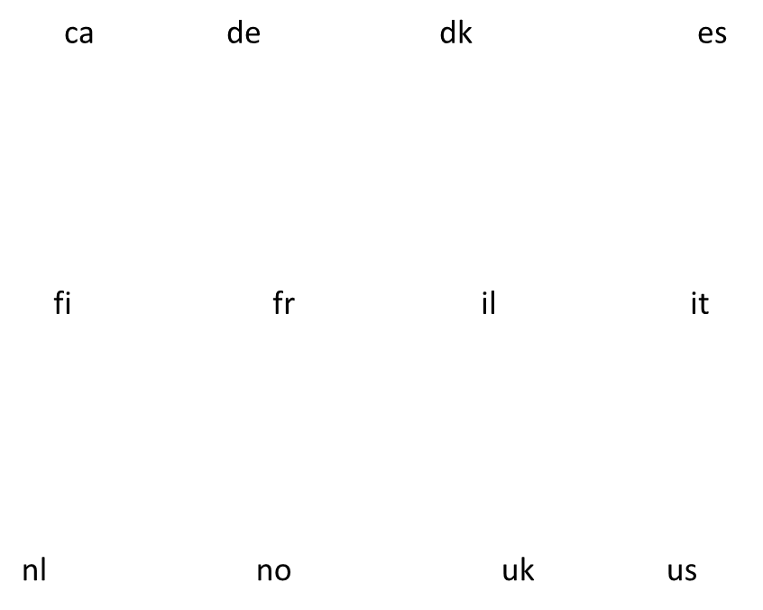
APCD (detrended) cohort coefficient of disposable per uc income, w controls
controls : education (ISCED code), sex, partner in household, # of children, immigrant-status.
Luxembourg Income Study microdata – 1980s to 2010s
Notes:
Martin
These figures show: how much different cohorts (people with different dates of birth) are below or above the long-run trend of economic growth, before and after controls are introduced.
Germany: Fortunate cohorts can have a living standards around 8 percent above of what one would expect when every cohort‘s income would have been proportionate with general trends of economic growth. But much of this is due to their better education etc. After this is controlled, only the cohorts born around 1945/50 are about 5 percent above the trend.
France: Fortunate cohort‘s living standard about 10 percent above the trend, unfortunate ones almost 10 percent below it. Even worse after controls are introduced (right side).
US: cohort‘s living standard does not diverge very much from the trend.
But how does this compare when set in relation to overall increases in living standards? APCT

Slide 48
APCT (trended) cohort coefficient of Gini indexes
Notes:
Martin
These figures show: how much different cohorts (people with different dates of birth) are below or above the long-run trend of economic growth, before and after controls are introduced.
Germany: Fortunate cohorts can have a living standards around 8 percent above of what one would expect when every cohort‘s income would have been proportionate with general trends of economic growth. But much of this is due to their better education etc. After this is controlled, only the cohorts born around 1945/50 are about 5 percent above the trend.
France: Fortunate cohort‘s living standard about 10 percent above the trend, unfortunate ones almost 10 percent below it. Even worse after controls are introduced (right side).
US: cohort‘s living standard does not diverge very much from the trend.
But how does this compare when set in relation to overall increases in living standards? APCT

Slide 49
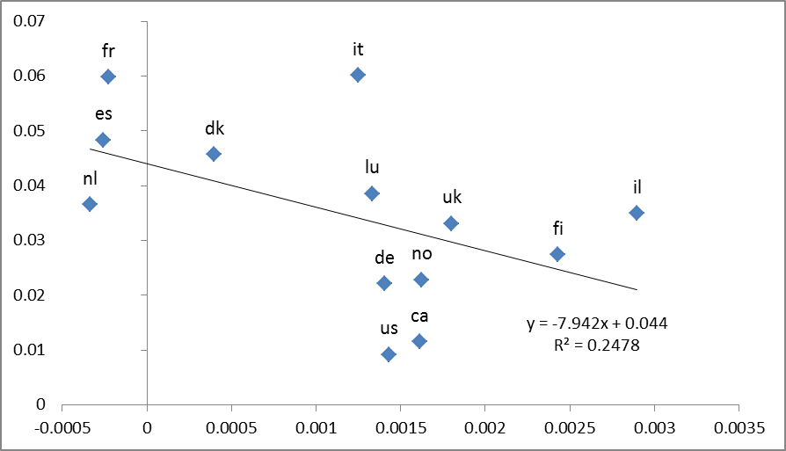
Intercohort inequality (after controls) and intracohort inequality dynamics
Intercohort inequality (non flat cohort profile)
intracohort inequality dynamics
(cohort growth of Gini index)
Notes:
Martin
These figures show: how much different cohorts (people with different dates of birth) are below or above the long-run trend of economic growth, before and after controls are introduced.
Germany: Fortunate cohorts can have a living standards around 8 percent above of what one would expect when every cohort‘s income would have been proportionate with general trends of economic growth. But much of this is due to their better education etc. After this is controlled, only the cohorts born around 1945/50 are about 5 percent above the trend.
France: Fortunate cohort‘s living standard about 10 percent above the trend, unfortunate ones almost 10 percent below it. Even worse after controls are introduced (right side).
US: cohort‘s living standard does not diverge very much from the trend.
But how does this compare when set in relation to overall increases in living standards? APCT

Slide 50

Conclusion
France is a very problematic case of young cohort economic slowdown
Italy, Spain, share very similar problems
=> there, the young get worse and the new seniors get relatively better
Reason: In conservative welfare state, the protection of insiders (the old) against outsiders (the young) produces strong difficulties in case of eco slow down, and then massive scarring effects
US not so bad? See closer in the details =
suicide rates in the US, opioid epidemics, etc. !!!
Notes:
Louis
Controlling for education, household composition, immigration status etc, we find that French cohorts born very early or late or strongly disadvantaged.
Unsurprising for pre-1930 cohorts in France: E.g. entering the working market in 1940 is not a great moment to enter the working market. But more disquieting is our finding about cohorts that have been born recently.

Slide 51
Louis Chauvel
Pr Dr at University of Luxembourg
louis.chauvel@uni.lu
http://www.louischauvel.org
inequality across birth cohorts
PART 4: APCGO and
a gender gap APC
The gender wag gap across cohorts: the role of education in 12 countries
IRSEI
Institute for Research
on Socio-Economic
Inequality

Slide 52



The gender wag gap across cohorts: the role of education in 12 countries
LIS working papers series - No. 737
Louis Chauvel, Anne Hartung, Eyal Bar Haim, Janet Gornick
University of Luxembourg,
PEARL Institute for Research on Socio-Economic Inequality (IRSEI)

Slide 53
Gender trends
The rise of women (DiPrete and Buchman 2013): women caught up and even overtook men in terms of educational attainment (Becker, Hubbard, and Murphy 2010; Breen, Luijkx, Müller and Pollak 2010; Buchmann and DiPrete, 2006; Grant and Behrman 2010)
Narrowing but recently stagnating gender gap in many countries (England, Gornick & Shafer 2012; Blau and Kahn 2008, 2016; Cambell and Pearlman 2013; Bernhardt, Morris, and Handcock 1995; Fitzenberger and Wunderlich 2002; Fransen, Plantenga, and Vlasblom 2010)
Education is seen as the most important predictor of
wages (Mincer 1958) and the gender wage gap (Polachek 1993)
Since education is at first a cohort phenomenon, cohort analysis is required
Campbell, C. and J. Pearlman. 2013. Period effects, cohort effects, and the narrowing gender wage gap. Social Science Research, 42(6): 1693-1711.
53

Slide 54
Our specific contribution
Analysis of the gap by cohort to understand timing / socialization
Role of education versus labor participation of women
Wage distribution when a large, declining share of the pop has wage = 0
Compare intensity of the gender gap in each educational level

Slide 55
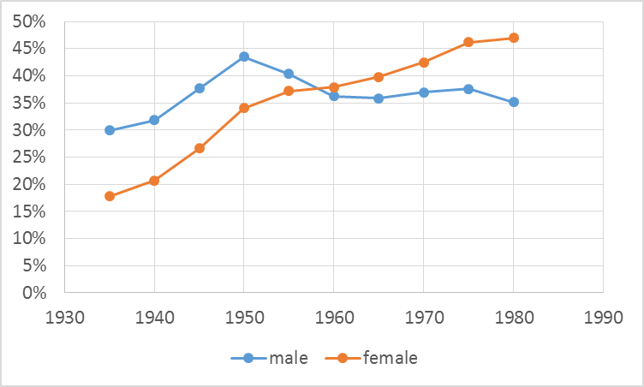
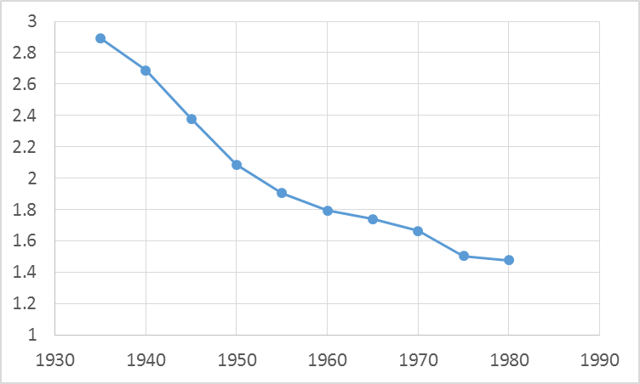
Reversed education gender gap and maintained wage gender gap in the U.S.
BA (or +) owners
Male to female wage income ratio
Birth cohort
Birth cohort
Source : IPUMS-CPS 1985-2010

Slide 56
Two relevant processes
See Paper Online
Educational expansion
  Educational expansion equipped women with better degrees and should eradicate the “legitimate” reason for the gender gap
  Occupation, work experience and industry are more relevant than education to explain the US gender wage gap (Blau and Kahn 2016)
  H1: The role of education in explaining the gender gap is and has been limited.
(2) Labour market transformation
  Disappearance of relatively well-paid, typically male occupied jobs in manufacturing → strongest equalization among lowest educated in the US
  US wage gap is wider at the top (Blau and Kahn 2016); female glass ceiling (Christofides et al 2013)
  H2: The trends in the gender wage gap differ between low and highly educated.
Notes:
Education seems necessary but not sufficient condition for narrowing gender gap
Given the gender segregation in occupations, also changes in the labour market structure impact on the gender gap

Slide 57
Gender gaps across space and time
See Paper Online
LIS working papers series - No. 737
Countries differ considerably in the gender wage gap (Harkness 2010; England, Gornick & Shafer 2012; Mandel 2012; Christofides et al. 2013)
  Not consistent with existing welfare state typologies (Mandel 2012)
Prevalence of cohort effect while most studies do not distinguish period and cohort effects
  Cohort effects (changes among young cohorts leaving education or entering the labour force) in education and labour market rather than period effects (effecting all age groups similarly)
    Clear example: Educational attainment – changes across cohorts but is relatively stable across age
    Campbell and Pearlman (2013) showing that US exhibits strong cohort effects in the gender wage gap
  Cohort studies can help understanding why and when women, based on their educational attainment relative to men, caught up in terms of wages in some countries, but not in others
Notes:
When cohorts are excluded, period effects are not accurately measured
Existing cohort studies: Limited number of cohorts, countries; log hourly wages

Slide 58
Data and variables
Luxembourg Income Study (LIS)
  Germany (DE), Denmark (DK), Spain (ES), Finland (FI), France (FR), Israel (IL), Italy (IT), Luxembourg (LU), the Netherlands (NL), Norway (NO), the UK and the US
  Cross-sectional survey – approx. each 5th year between 1985 and 2010
  Sample: aged 25-59 years so that we can observe graduation from tertiary education and exclude elderly
Variables
  5-year birth cohorts between 1935 and 1980
  Highest level of education: non- tertiary vs tertiary education
  Wages: comprise paid employment income including basic wages, wage supplements, director wages and casually paid employment income but not self-employment income
    Standardised with logit-rank transformation as proposed by Chauvel (2016)

Slide 59
APC-GO (Gap/Oaxaca) model
Now on Stata: ssc install apcgo
  APC-GO is a APC model to provide a cohort analysis in gaps in outcomes between 2 groups after controlling for relevant explanatory variables
  e.g. (gender) gaps in income net of education effects
  or (racial) gaps in education net of State/county effects
Ingredients:
  Computation of Oaxaca decomposition in unexplained/explained gaps by A x P cell
  Estimate of APC-lag gaps with a focus on cohort
  Bootstrapping to obtain confidence intervals

Slide 60
Structure of data
See Paper Online
Lexis table / diagram:
  Age a indexed by a from 1 to A
  Period by p from 1 to P
  Cohort by c = p – a + A
  from 1 to C
Cross-sectional surveys
including one outcome y
and controls x
Condition: Large sample
with data for each cell (APC)
of the Lexis table
c = p – a + A

Slide 61
Part I: Blinder-Oaxaca decomposition in each cell apc of the Lexis Table
See Paper Online
For each cell of the Lexis Table one Blinder Oaxaca decomposition is proceeded
So we transform the y_{apc} in each cell in an aggregate: the Oaxaca-blinder unexplained part u_{apc}
Blinder Oaxaca decomposition (Blinder 1973; Oaxaca 1973; Jann 2008):
  Y1 = X1b1 + e1 for male
  Y2 = X2b2 + e2 for female
mean outcome difference between the two groups can be decomposed as
R = x1'b1 - x2'b2
= (x1-x2)'b2 + x2'(b1-b2) + (x1-x2)'(b1-b2)
= E + [ C + CE ]
E: gap in ‘endowments’ (“explained”)
C: gap in ‘coefficients’ (“unexplained” 1 ) / CE: interaction of diff in endow & coef (“unexplained” 2)
In the twofold Oaxaca Decomposition, U = C+CE are the unexplained difference
From the initial y_{apc} we generate Oaxaca-Lexis-table of unexplained part u_{apc}
e.g. Owen O’Donnell, Eddy van Doorslaer, Adam Wagstaff and Magnus Lindelow, “Analyzing Health Equity Using
Household Survey Data” The World Bank, Washington DC, 2008, www.worldbank.org/analyzinghealthequity and http://fmwww.bc.edu/RePEc/bocode/o/oaxaca8.html

Slide 62
Part II: APC-lag of the u_{apc}
See Paper Online
APC-Detrended as an identifiable solution of age, period and cohort non-linear effects (Chauvel, 2013, Chauvel and Schröder. 2014, Chauvel et al., 2016)
β₀ is the constant
is a two-dimensional linear (=hyperplane) trend
are 3 vectors of age, period and cohort fluctuations
To solve the “identification problem” (a=p-c ), a meaningful constraint is needed: trend in α_{a} = the average of the longitudinal shift observed in u_{apc}

Slide 63
Part II: APC-lag of the u_{apc}
See Paper Online
= [Σ (u(a+1, p+1, c) - uapc)] / [(A-1) (P-1)]
is the average longitudinal age effect along cohorts
(= the average difference between u_{(a+1, p+1, c)}
and its cohort lag u_{apc} across the table)
The APC-lag solution
Operator Trend for age coefficients:
α
APC-lag delivers a unique estimate of
vector γ_{c} a cohort indexed measure of gaps
Average γ_{c} is the general intensity of the gap
Trend of γ_{c} measures increases/decreases of the gap in the window of observation
Values of γ_{c} show possible non linearity
The γ_{c} can be compared between countries

Slide 64
Summary
APC-GO combines the different steps
Oaxaca of the cells of the initial Lexis table data generates an aggregated Oaxaca Lexis table of measures of gaps
unexplained by controls
APC-lag of the Oaxaca Lexis table deliver notably γ_{c} coefficients
Bootstrapping to obtain confidence intervals
→ See Stata ado file, ssc install apcgo

Slide 65
The Gender gap in Education & Wages in 12 countries

Slide 66
Educational expansion by gender
Figure 1: Attainment of tertiary education among men (blue) and women (red), over birth cohort
Source: LIS
Notes:
Men in the US and Italy: stagnation

Slide 67
Reversal of gender gap in education
Figure 2: Difference in attainment of tertiary education between men and women, over birth cohort
Male advantage
Female advantage
Notes:
TO DO:
Drop CA
Reverse *-1
DONE:
Reran with 100 reps

Slide 68
Narrowing of gender wage gap
Figure 3: Gender gap in logit-rank of wages, over birth cohort
Male advantage
Gender parity
Source: LIS

Slide 69
Gender wage gap by education
Figure 4: Gender wage gap for non-tertiary educated (red) and tertiary educated (blue), over birth cohort
Male advantage
Gender parity
Source: LIS
Notes:
= previous 2 slides in 1
TO DO
Reverse *-1
Label 2 lines
Chng CI (eg area vs black lines)

Slide 70
The unexplained gender wage gap
Figure 6: Blinder-Oaxaca decomposition including education, family and employment status :
Total wage difference (blue) and unexplained difference (green)
Source: LIS
Notes:
CONCLUSION: remaining unexplained gender wage gap is substantial
→ pointing towards other explanations

Slide 71
Convergence of the gender composition of the top Quartile
U.S.
Figure 7: percentage male population in the top quartile group Q4
Male advantage
50% ➔ Gender equality
Notes:
CONCLUSION: remaining unexplained gender wage gap is substantial
→ pointing towards other explanations

Slide 72
Convergence of the gender composition of the top Decile
U.S.
Figure 8: percentage male population in the top decile group D10
Male advantage
50% ➔ Gender parity
Notes:
CONCLUSION: remaining unexplained gender wage gap is substantial
→ pointing towards other explanations

Slide 73
Convergence of the gender composition of the top Decile
U.S.
Figure 8: percentage male population in the top ventile group V20 (top 5%)
Male advantage
50% ➔ Gender parity
Notes:
CONCLUSION: remaining unexplained gender wage gap is substantial
→ pointing towards other explanations

Slide 74
Conclusions
Gender wage gap decreased over cohorts in all the countries
  Small decreases in countries with already low gender gap: FI and US
  Large but sharply declining gender gap over cohorts in DE, ES, IT, NL and LU
  Largely due to declining in explained differences
The intrinsic role of education is limited in explaining the gender wage gap
  = large and continuing wage gaps among higher educated
A persistent unexplained part of the gap over cohorts except for UK
Slowing down in the most recent cohorts in NL, FI, FR, IL, NL, US
Future studies
  Compare the role of the different equalizing factors (educ. / labor participation / etc.)
  Gender composition of top incomes
  Compare the role of welfare regimes in the reducing gender gap
Notes:
But: no info on field of study of specific diploma (nurse vs. doctor)
And we look at overall wage levels – not at hourly wages: women remain contributing significantly less wage to the household income relative to men

Slide 75
Thanks!

Slide 76
General Conclusion
  Cohort analysis vital to understand historical non-linear changes
  Demographic metabolism: the young replace the old
  In case of cohort inertia, difficult to change trajectories
  Public policies should prioritize (in general) investment in youth
  Enrich the concept of (long term) sustainability
  Social philosophy aspects: Hans Jonas
  The Imperative of Responsibility: In Search of Ethics for the Technological Age (translation of Das Prinzip Verantwortung) trans. Hans Jonas and David Herr (1979). (University of Chicago Press, 1984)
  “Act so that the effects of your action are compatible with the permanence of genuine human life”
  Important tool for future prediction
Notes:
But: no info on field of study of specific diploma (nurse vs. doctor)
And we look at overall wage levels – not at hourly wages: women remain contributing significantly less wage to the household income relative to men

