Slide 1


REPLICATION CUNY WORKSHOP 2020
Louis Chauvel
Pr Dr at University of Luxembourg
louis.chauvel@uni.lu
http://www.louischauvel.org
http://www.louischauvel.org/Replication_cuny_2020_0.ppt.pptx
Introduction
IRSEI
Institute for Research
on Socio-Economic
Inequality
Sept 2020
Download these slides here
http://www.louischauvel.org/Replication_cuny_2020.html

Slide 2
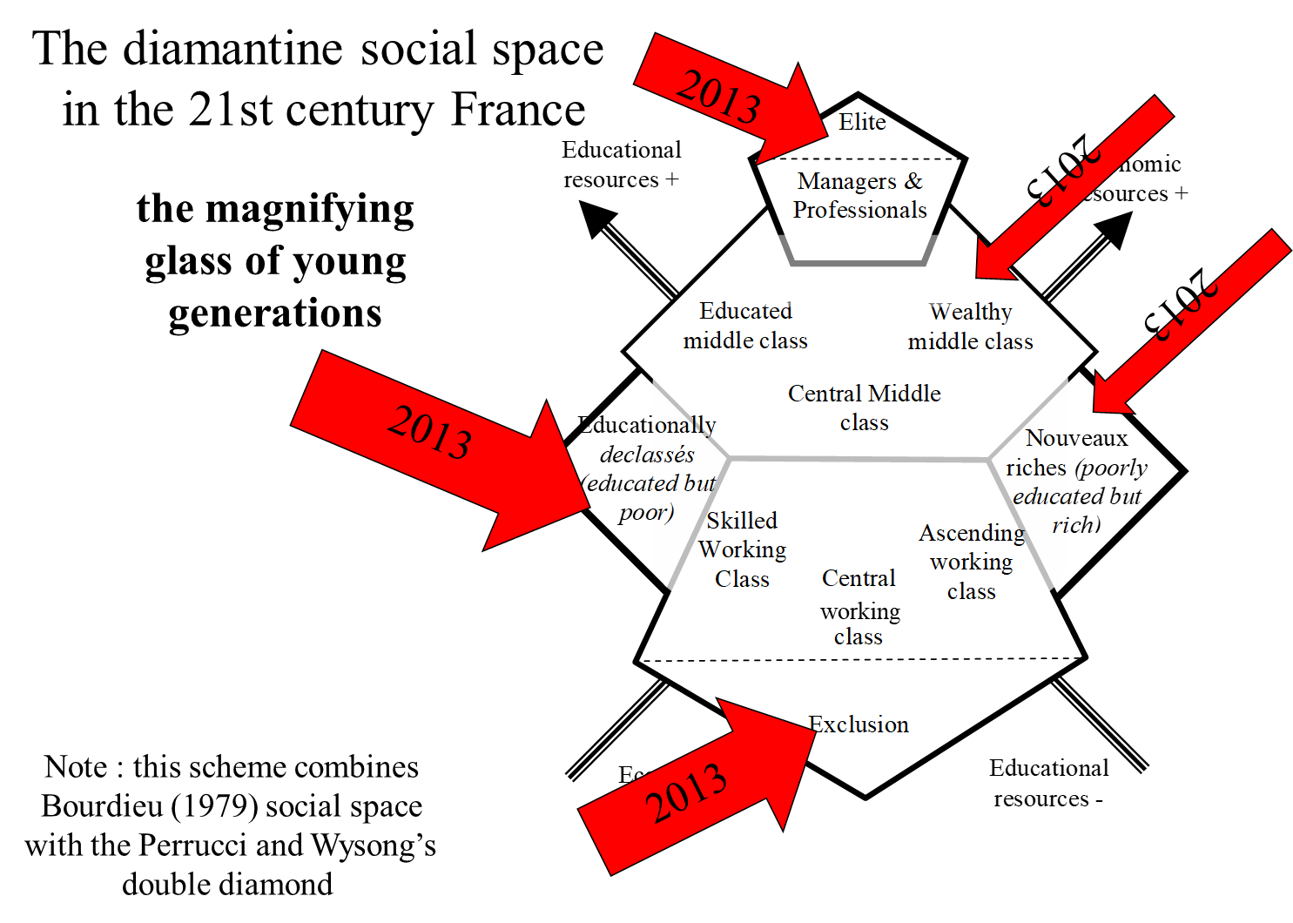
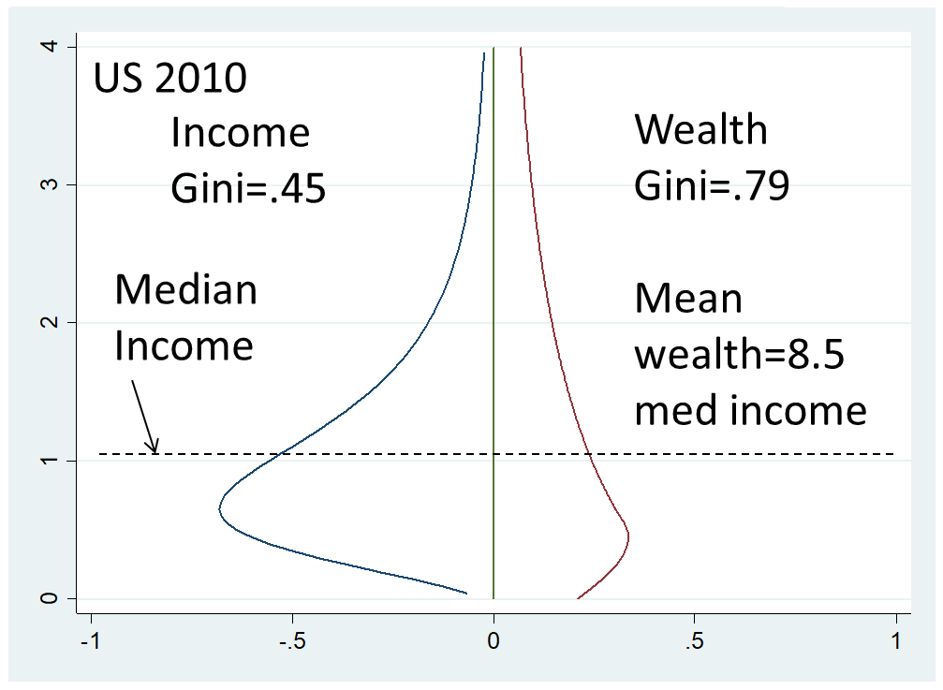
www.louischauvel.org
Extreme inequalities & wealth distributions | Middle class dynamics & class structures
Models of comparative socio historical change | Generational/Cohort change

Slide 3
Introduction
1- LIS and access to Lissy
2- Pr Janet Gornick’s 2020 CUNY workshop presentation
3- Lissy and Stata programming
4- New 2020 Lissy features
5- Replication as science
Notes:
Louis

Slide 4
  1. LIS and access to Lissy
  Follow the main links to LIS information:
  https://www.lisdatacenter.org/
  Look for Lissy access (your login/password) here,
  https://www.lisdatacenter.org/data-access/lissy/eligibility/
  Then real access to Lissy : https://webui.lisdatacenter.org/
  See the 2020 introduction videos https://www.lisdatacenter.org/resources/online-tutorial-series/

Slide 5
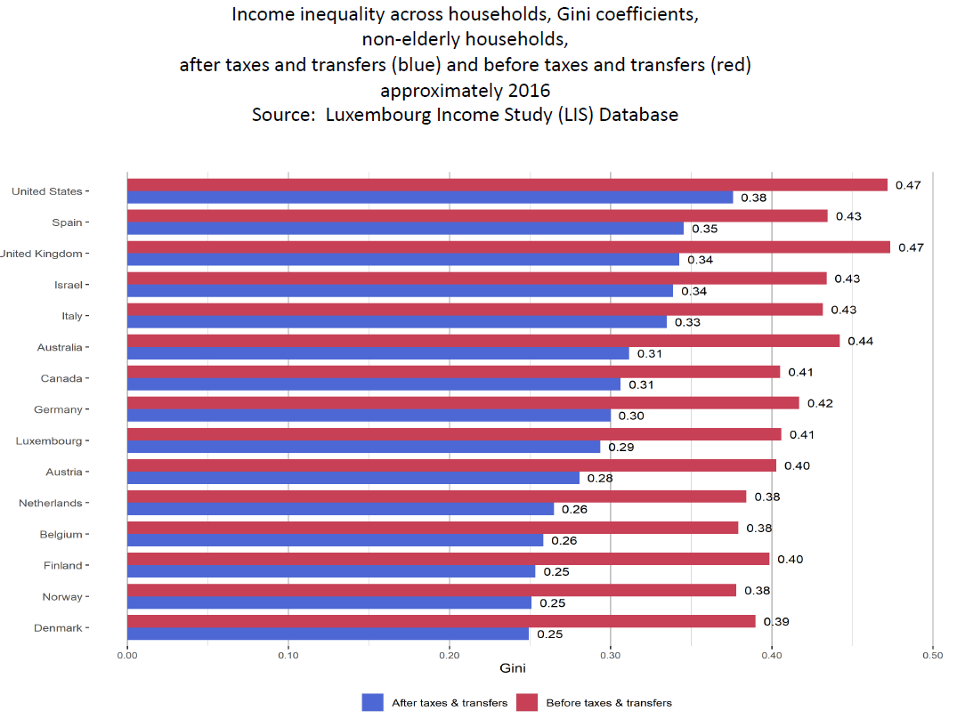
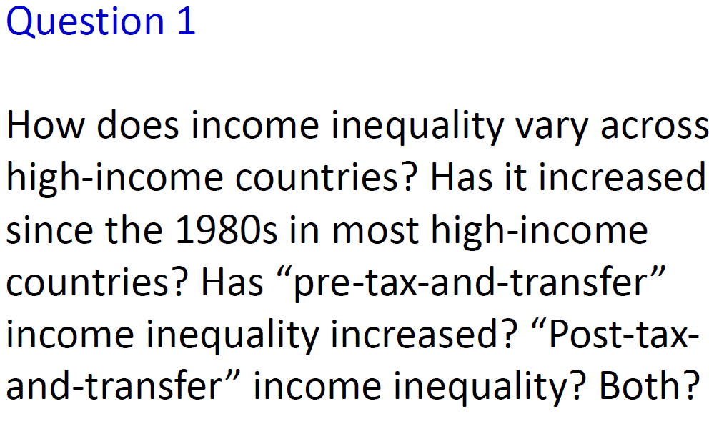
  2. Pr Janet Gornick in 2020 CUNY workshop
  The CUNY 2020 workshop :
  https://stonecenter.gc.cuny.edu/news-and-commentary/inequality-by-the-numbers-2020/
  “LIS Data: A Resource for Inequality Research” ➔ an important introduction to LIS
  https://stonecenter.gc.cuny.edu/files/2020/08/Gornick-LIS-Session-2020-final.pdf
  QUESTION : Can we replicate+ the Janet’s results? (ANSWER = YES!)
Ex: Janet’s slide 14/15
5

Slide 6
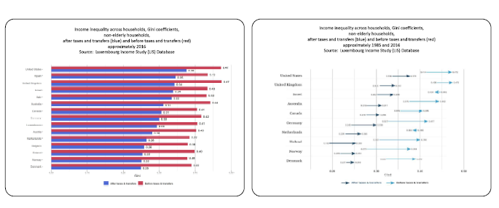
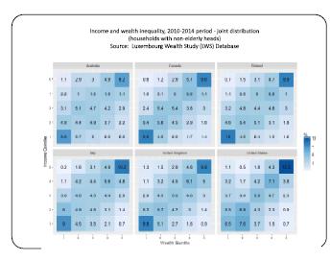
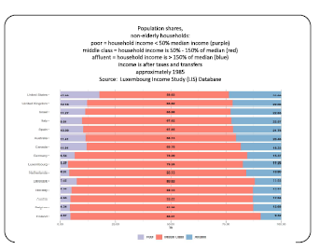
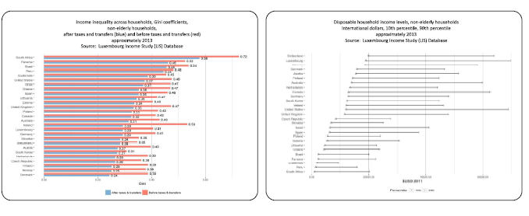
  QUESTION : Can we replicate+ the Janet’s results? (ANSWER = YES!)
  The concept of replicate+ means the inclusion of possible updates and modification of the stata program for variants versus other purposes …
  So in the Janet’s slides https://stonecenter.gc.cuny.edu/files/2020/08/Gornick-LIS-Session-2020-final.pdf
  We aim at replicate+ the slides/pages 15 16 18/19 21 22 26 (+24)
http://www.louischauvel.org/Replication_cuny_2020.html

Slide 7
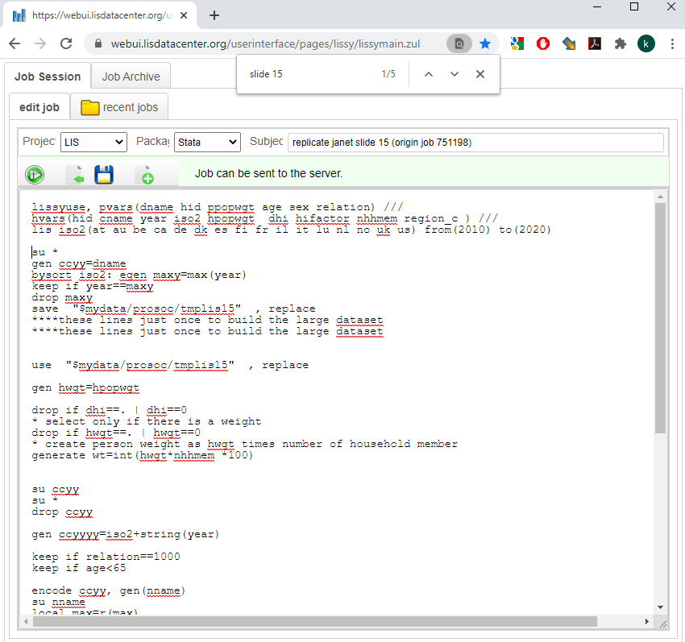
  3. Lissy and stata programming
  Access to Lissy in real life : https://webui.lisdatacenter.org/

Slide 8
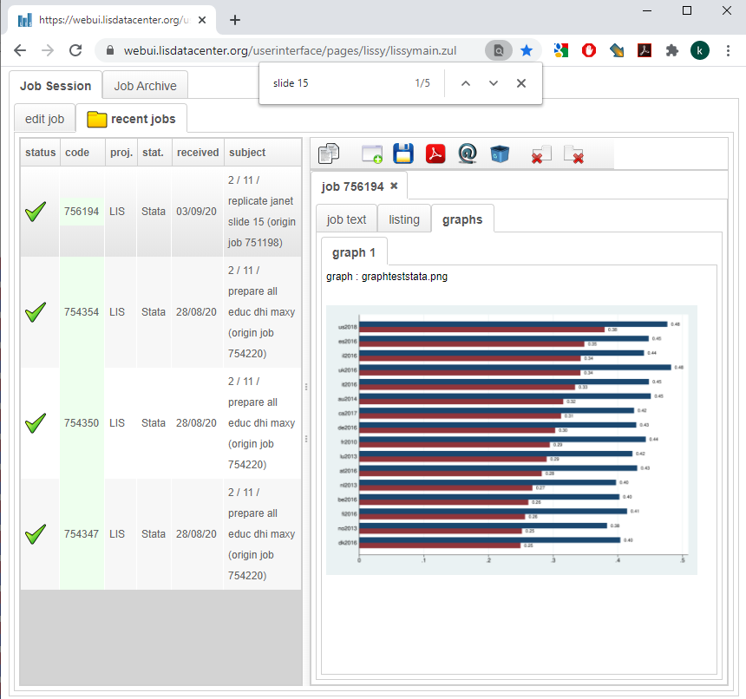
  Access to Lissy in real life : https://webui.lisdatacenter.org/

Slide 9
4- New 2020 Lissy features
  Plenty of new things in Lissy 2020 :
  Graphics !!!
  Easy tool to assemble country/years lissyuse
  PPP values conversion
  And much more (erf… etc.)

Slide 10


5- Just to conclude the intro:
  Science IS replication
  non-replicability = nil
  Hope for total replicability as a future standard in publications …
Thanks!
And see you in the next sessions…

