Slide 1


REPLICATION CUNY WORKSHOP 2020
Louis Chauvel
Pr Dr at University of Luxembourg
louis.chauvel@uni.lu
http://www.louischauvel.org
http://www.louischauvel.org/Replication_cuny_2020_1.pptx
Countries comparisons:
Pre- & post-tax Gini : “Slide 15”
IRSEI
Institute for Research
on Socio-Economic
Inequality
Sept 2020
Download these slides here
http://www.louischauvel.org/Replication_cuny_2020.html

Slide 2
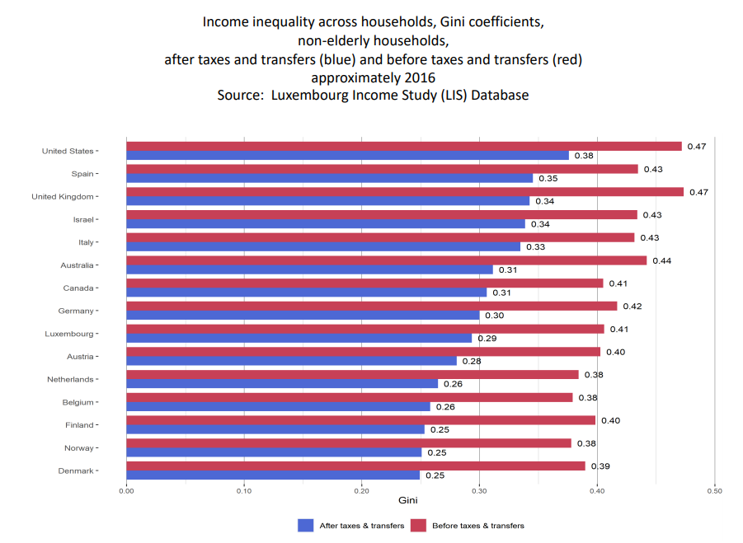
We consider SLIDE 15 of Janet Gornick’s presentation
(https://stonecenter.gc.cuny.edu/files/2020/08/Gornick-LIS-Session-2020-final.pdf)

Slide 3
Introduction
1- The question on Slide 15
2- Big concepts there
3- Stata programming
4- Lissy implementation
5- Exercise …
Notes:
Louis

Slide 4
  1. The question on Slide 15
  “Question 1 How does income inequality vary across high-income countries? (…) “pre-tax-and-transfer” (…)
  “Post-tax-and-transfer” income inequality?”
  (Gornick 2020 slide 14)
  So we have to compare Gini indices (f.ex.)
  For relevant country-years (which ones?)
  For (equivalised, how/why?) disposable income (=after T&T)
  And compare with factor incomes (=before T&T)
  (only non-elderly, why?)
  (what about the LIS weighhtig, outliers etc. routine treatment?)

Slide 5
We consider SLIDE 15 of Janet Gornick’s presentation
(https://stonecenter.gc.cuny.edu/files/2020/08/Gornick-LIS-Session-2020-final.pdf)

Slide 6
  2. Big concepts there
  Gini indices (alternative?)
  For relevant country-years (which ones?)
  For (equivalised, how/why?) disposable income (=after T&T)
  And compare with factor incomes (=before T&T)
  (only non-elderly, why?)
  (what about the LIS weighhtig, outliers etc. routine treatment?)
6

Slide 7
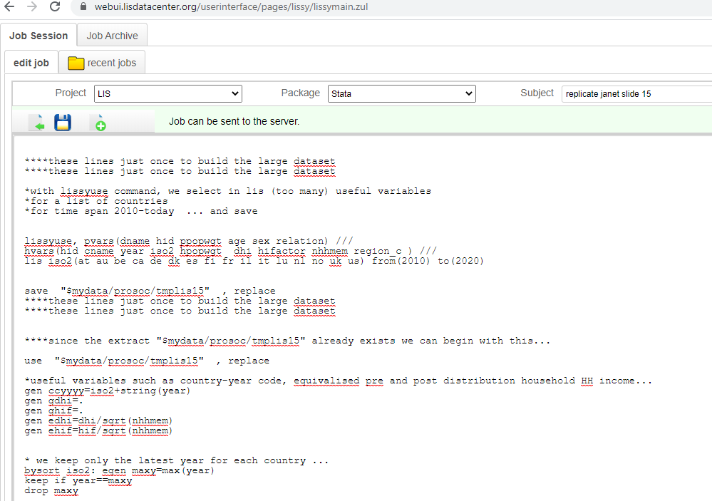
  3. Stata programming
  See the programme : http://www.louischauvel.org/slide15.txt

Slide 8
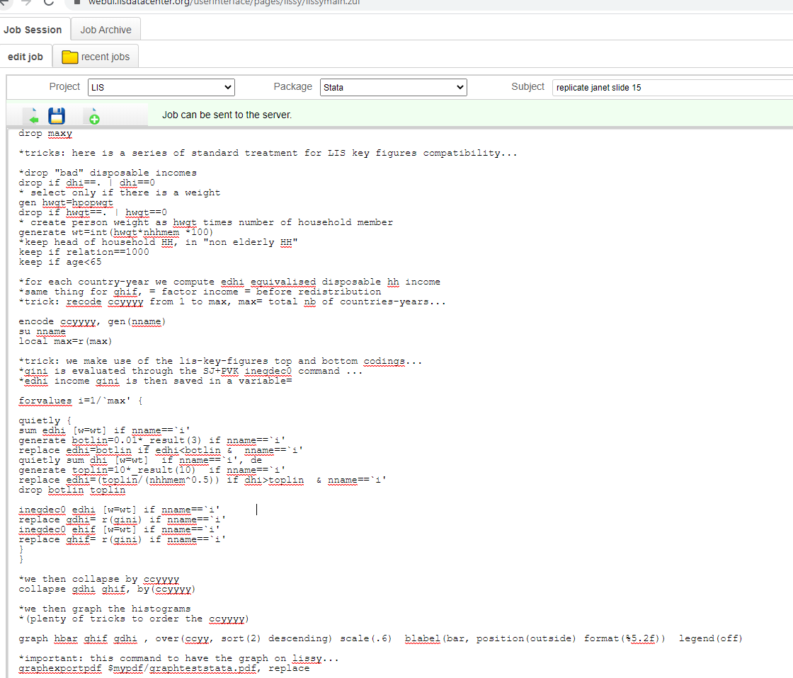
  3. Stata programming
  See the programme : http://www.louischauvel.org/slide15.txt

Slide 9

4- Lissy implementation
  Copy the programme from the homepage
  Paste it on your https://webui.lisdatacenter.org/
  Execute …. Wait 3 minutes (depending on LIS traffic jams)
  And read the results …

Slide 10
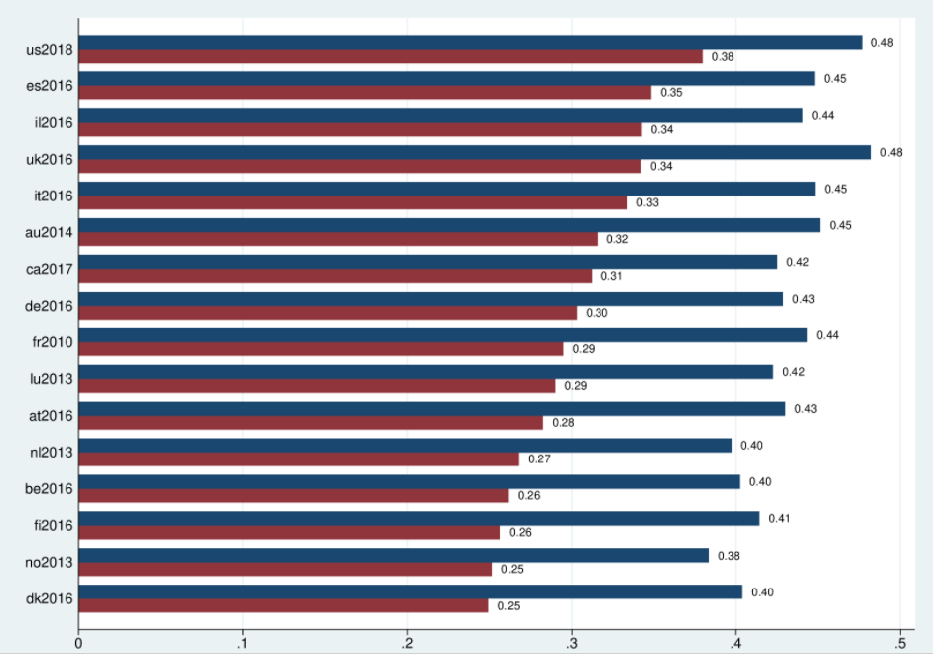
4- Lissy implementation
  Copy the programme from the homepage
  Paste it on your https://webui.lisdatacenter.org/
  Execute …. Wait 3 minutes (depending on LIS traffic jams)
  And read the results …

Slide 11
  Comments:
  The U.S., Spain (ES) and the U.K. are the most unequal countries
  Northern European countries are less
  In general, the Gini of the equivalised disposable income after redistribution is average 0.1 lower than before
  Northern European countries redistribute more

Slide 12


5- Exercice:
  Compare the same way Latin American countries …
  So it is simple and you can now detect “extreme inequality” countries
  (ex: za 2017) to be contrasted with f.ex Northern European countries
  … or early post socialist countries (ex: sk 1992)
  Enjoy …
Thanks!
And see you in the next sessions…

Slide 13
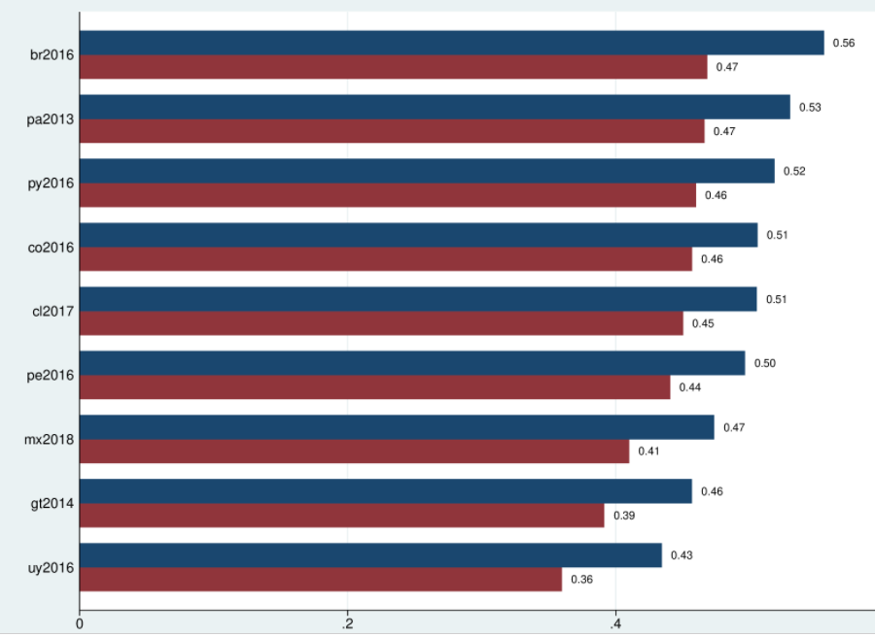

Slide 14
