Slide 1


REPLICATION CUNY WORKSHOP 2020
Louis Chauvel
Pr Dr at University of Luxembourg
louis.chauvel@uni.lu
http://www.louischauvel.org
http://www.louischauvel.org/Replication_cuny_2020_2.pptx
Countries dynamic comparisons:
Pre- & post-tax Gini 1985-2015:
“Slide 16”
IRSEI
Institute for Research
on Socio-Economic
Inequality
Sept 2020
Download these slides here
http://www.louischauvel.org/Replication_cuny_2020.html

Slide 2
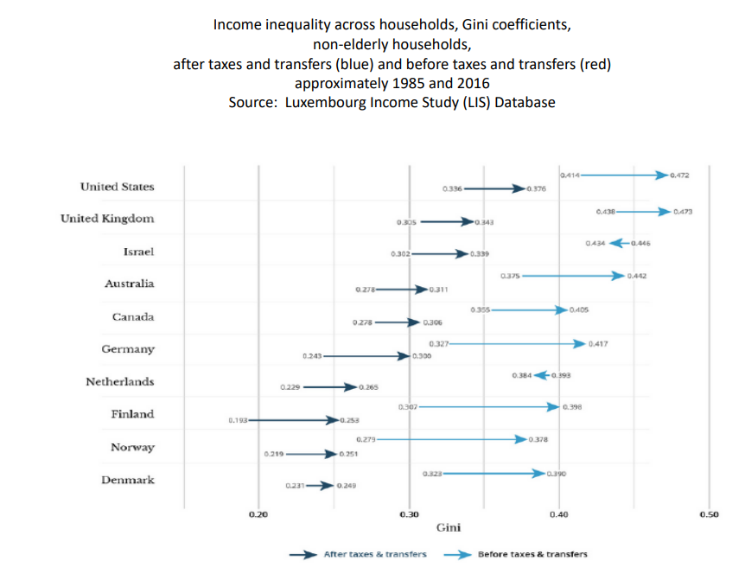
We consider SLIDE 16 of Janet Gornick’s presentation
(https://stonecenter.gc.cuny.edu/files/2020/08/Gornick-LIS-Session-2020-final.pdf)

Slide 3
Introduction
1- The question on Slide 16
2- Some concepts here
3- Stata programming
4- Lissy implementation
5- Exercise …
Notes:
Louis

Slide 4
  1. The question on Slide 16
  “Question 1 Has <income inequality> increased since the 1980s in most high-income countries? Has “pre-tax-and-transfer” income inequality increased? “Post-taxand-transfer” income inequality? Both?”
  (Gornick 2020 slide 14)

Slide 5
We consider SLIDE 16 of Janet Gornick’s presentation
(https://stonecenter.gc.cuny.edu/files/2020/08/Gornick-LIS-Session-2020-final.pdf)

Slide 6
  2. Big concepts here
  So we have to compare Gini indices (f.ex.)
  Over time (mid 1980s’ and most recent year possible)
  And for different countries (au ca de dk fi il nl no uk us)
  For equivalised disposable income (=after T&T)
  And equivalised factor incomes (=before T&T)
  (only non-elderly, why?)
  (what about the LIS weightig, outliers etc. routine treatment?)
6

Slide 7
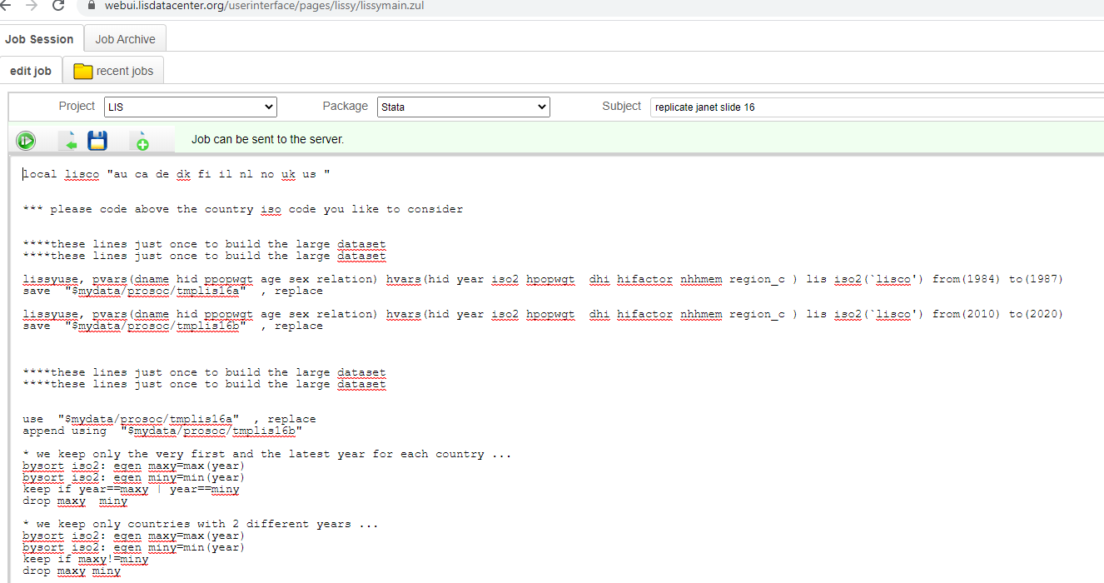
  3. Stata programming
  See the programme : http://www.louischauvel.org/slide16.txt
  This is a complexification of slide 15, to include time.
  We open two period spans near to 1985 and to today, and then take first and last year of the appended file

Slide 8
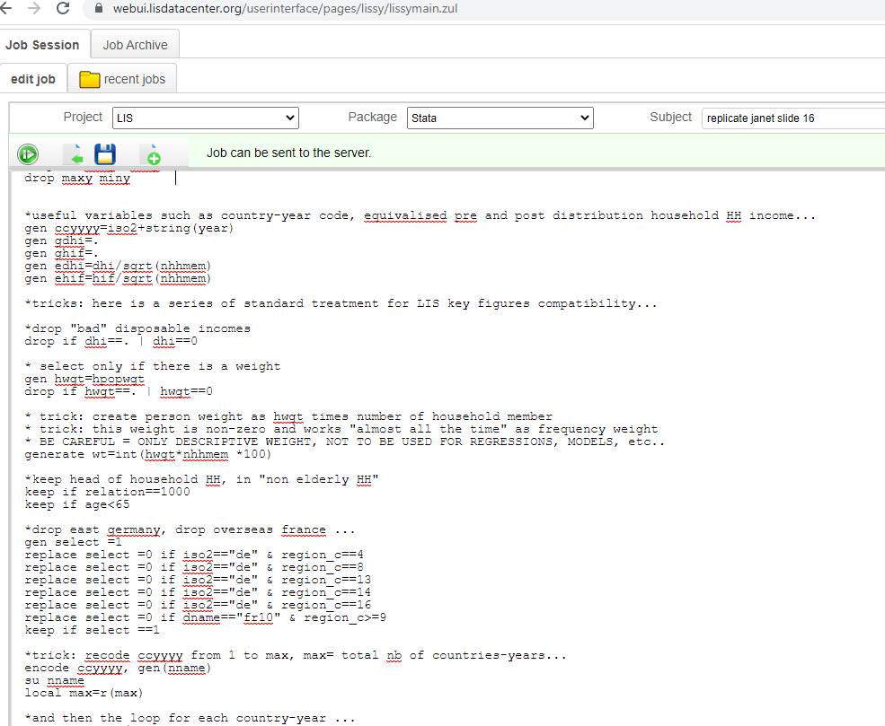
  3. Stata programming
  We then create (like slide 15) appropriate variables, weights, selection of populations (elderly and geographic comparability…), then the loop …

Slide 9
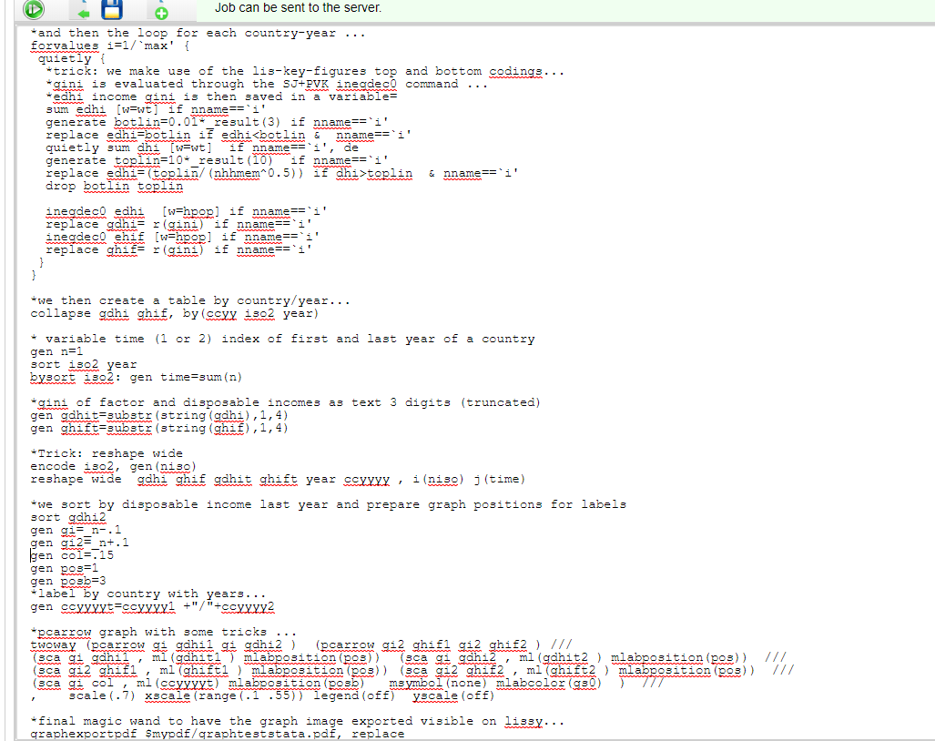
  3. Stata programming
  then the loop …

Slide 10

4- Lissy implementation
  Copy the programme from the homepage http://www.louischauvel.org/slide16.txt
  Paste it on your https://webui.lisdatacenter.org/
  Execute …. Wait 7 minutes (depending on LIS traffic jams)
  And read the results …

Slide 11
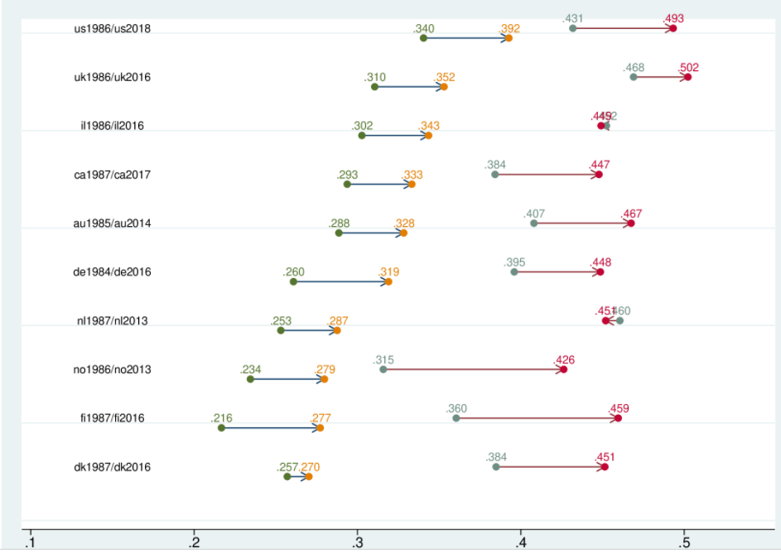
4- Lissy implementation
“post-tax-and-transfer” gini
“pre-tax-and-transfer” gini

Slide 12
  Comments:
  “increasing inequality everywhere”
  “pre-tax-and-transfer” gini worse
  “pre-tax-and-transfer” gini worsen in Nordic countries
  “post-tax-and-transfer” gini more stable in Nordic countries
  Your comments ? …

Slide 13


5- Exercice:
  Compare with Southern European countries (ES IT FR)…
  Compare with Latin American countries (period 2000 / recent)
  Enjoy …
Thanks!
And see you in the next sessions…

Slide 14
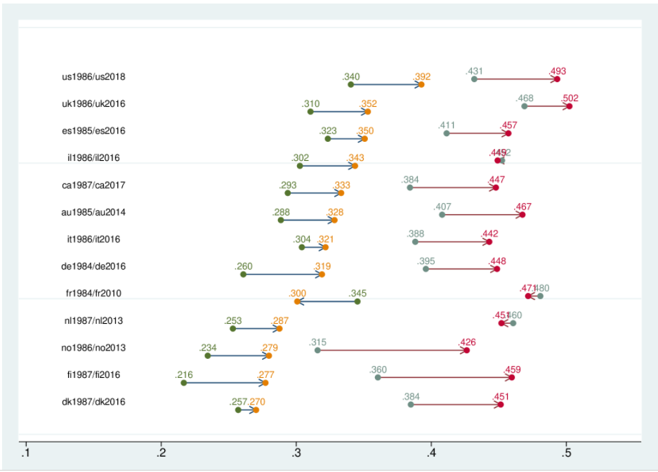

Slide 15
