Slide 1


REPLICATION CUNY WORKSHOP 2020
Louis Chauvel
Pr Dr at University of Luxembourg
louis.chauvel@uni.lu
http://www.louischauvel.org
http://www.louischauvel.org/Replication_cuny_2020_3.pptx
Countries dynamic comparisons of income classes:
The middle class between 1985-2015:
“Slide 18/19”
IRSEI
Institute for Research
on Socio-Economic
Inequality
Sept 2020
Download these slides here
http://www.louischauvel.org/Replication_cuny_2020.html

Slide 2
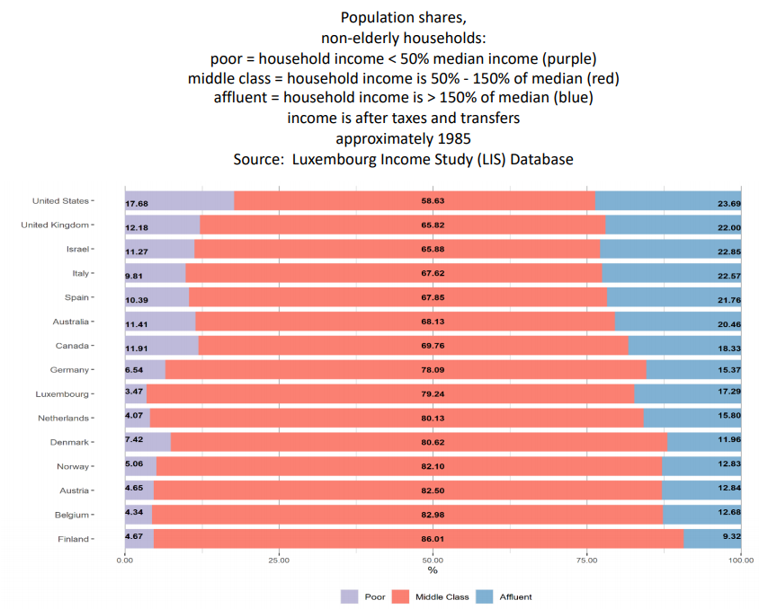
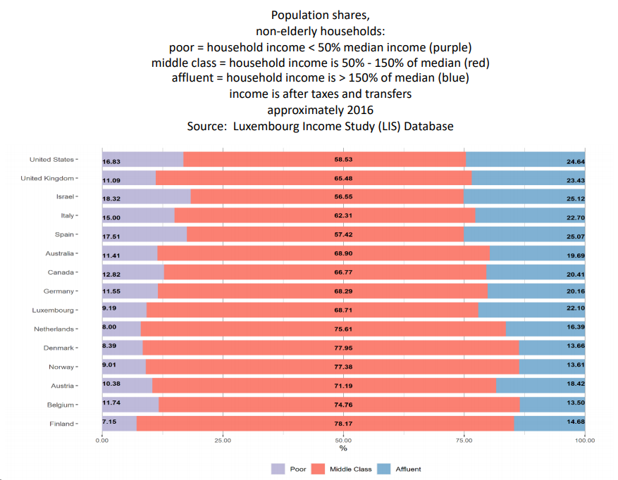
We consider SLIDE 18/19 of Janet Gornick’s presentation
(https://stonecenter.gc.cuny.edu/files/2020/08/Gornick-LIS-Session-2020-final.pdf)

Slide 3
Introduction
1- The question on Slide 18/19
2- Some concepts here
3- Stata programming
4- Lissy implementation
5- Exercise …

Slide 4
  “We hear a lot about “the hollowing out of
  the middle”. During the last three decades,
  what exactly has taken place in the middle
  of the income distribution? Has the size of
  “the middle” shrunk?”
  (Gornick 2020 slide 17)
  1. The question on Slide 18/19

Slide 5
We consider SLIDE 18/19 of Janet Gornick’s presentation
(https://stonecenter.gc.cuny.edu/files/2020/08/Gornick-LIS-Session-2020-final.pdf)

Slide 6
  2. Big concepts here
  Almost all similar to slide 16 …
  The difference?
  Histograms of poor / middle class / affluent percentage share
  by country (15) ( au at be ca de dk es fi il it lu nl no uk us )
  and for time = 1 versus 2
  Based on the median of the equivalized disposable income (medi)
  Income below 50% of medi ➔ poor (relative poverty)
  Income above 150% of medi ➔ affluent
  Income between 50 and 150% of medi ➔ middle class
  So we just change the loop of slide 16 and the following lines…
6

Slide 7
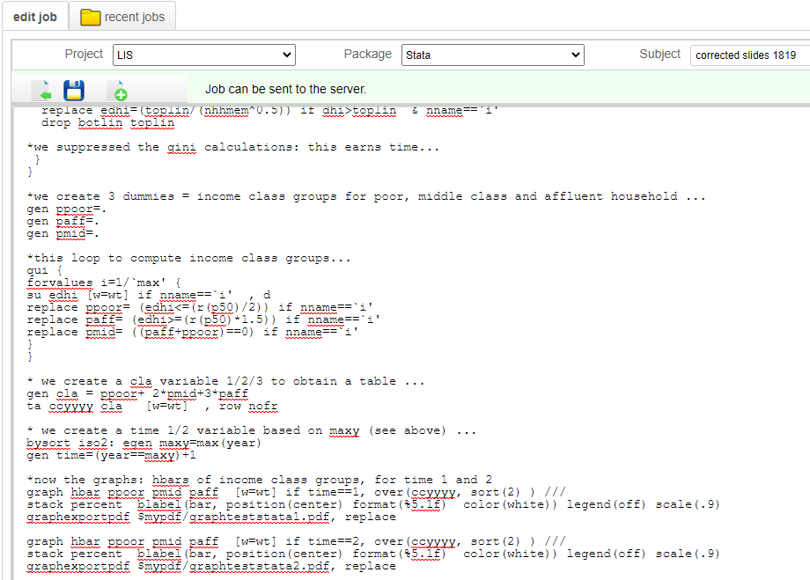
  3. Stata programming
  See the programme : http://www.louischauvel.org/slide1819.txt
  This is a modification of slide 16... We change only the end (from the loop)

Slide 8

4- Lissy implementation
  Copy the programme from the homepage http://www.louischauvel.org/slide1819.txt
  Paste it on your https://webui.lisdatacenter.org/
  Execute …. Wait 4 minutes (depending on LIS traffic jams)
  And read the results …

Slide 9
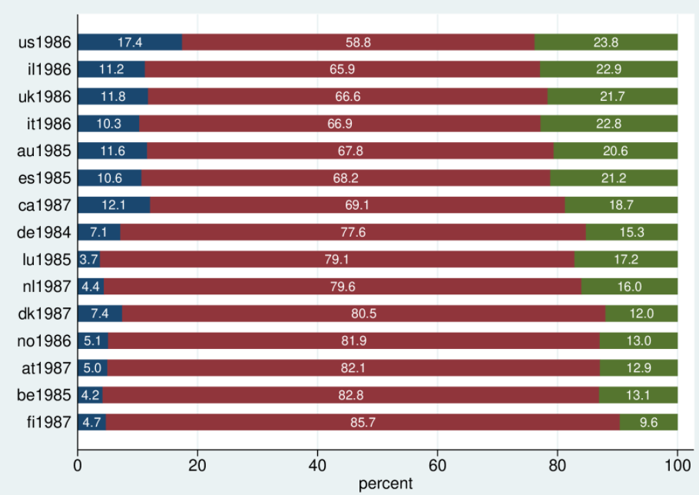
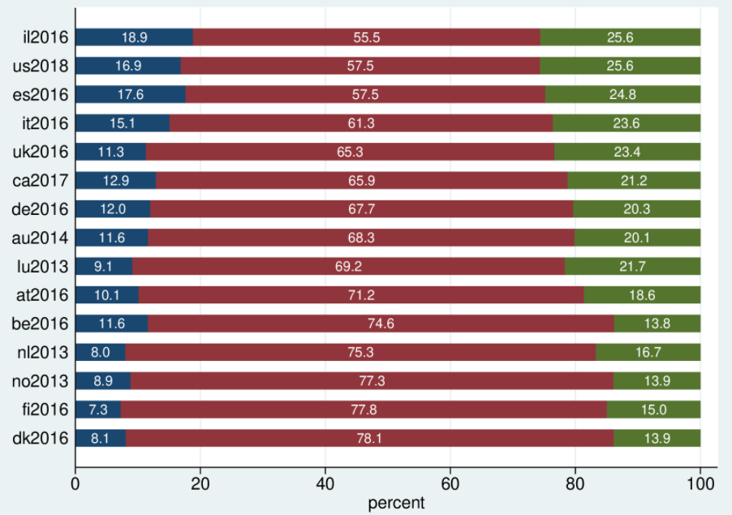
4- Lissy implementation
1980s’
“recent” years

Slide 10
  Comments:
  More affluent people than poor (why?... :)
  The U.S. and Israel at the top …
  Nordic countries still have a larger income middle class
  The trend of “shinking middle class” is well assessed
  Changes in ranks help detect strong transformations
  Your comments ? …

Slide 11


5- Exercices:
As usual!
  Include France ?
  Include Latin American countries (period 2000 / recent)
  Enjoy …
Thanks!
And see you in the next sessions…

