Slide 1


Session 6
Event History Analysis / survival
(and other tools for social and individual transitions)
Advanced quantitative methods for social scientists (2017–2018)
LC & PVK
Louis Chauvel
University of Luxembourg,
PEARL Institute for Research on Socio-Economic Inequality (IRSEI)

Slide 2
Outline
in the context of:
Louis Chauvel & Anne Hartung & Flaviana Palmisano, 2017. "Dynamics of Income Rank Volatility: Evidence from Germany and the US," SOEPpapers on Multidisciplinary Panel Data Research, 926, DIW Berlin, The German Socio-Economic Panel (SOEP). http://orbilu.uni.lu/handle/10993/32294
References
Background, context, usefulness
Notations, terminology
Method on standard examples:
  Parametric models
  Cox semi-parametric
Method with the PSID panel and fertility
  Parametric models
  Cox semi-parametric
Further developments on panel analysis

Slide 3
Log-log graph of total fertility rate (TFR) vs. GDP (PPP) per capita with population size shown as bubble area, for all countries having population greater than 2 million (2016 estimates; 30 largest countries bold).
https://en.wikipedia.org/wiki/Total_fertility_rate

Slide 4

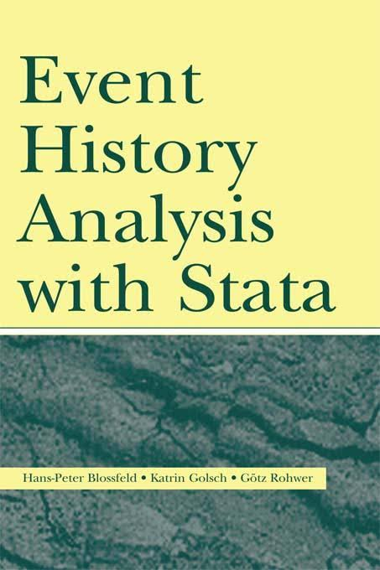
Main references
https://www.iser.essex.ac.uk/files/teaching/stephenj/ec968/pdfs/ec968st1.pdf
UNIVERSITY OF ESSEX / INSTITUTE FOR SOCIAL AND ECONOMIC RESEARCH
Professor Stephen P. Jenkins <stephenj@essex.ac.uk>
Essex Summer School course ‘Survival Analysis’
http://melindacmills.com/introducing-survival-and-event-history-analysis/
R
Event History Analysis With Stata
Hans-Peter Blossfeld, Katrin Golsch, Gotz Rohwer, LE press, Oct 12, 2007
Stata

Slide 5
And also
UCLA as usual: https://stats.idre.ucla.edu/stata/seminars/stata-survival/
http://www.sebastianjaeckle.de/teaching/eventhistory_trondheim2011.pdf
Southampton Statistical Sciences Research Institute / University of Southampton
Lecture 6: Survival Analysis / Dankmar Boehning
Lecture7: Survival Analysis / Antonello Maruotti
Etc…

Slide 6
Background, context, usefulness

Slide 7
Notations, terminology
http://www.sebastianjaeckle.de/teaching/eventhistory_trondheim2011.pdf

Slide 8
Notations, terminology

Slide 9
Notations, terminology

Slide 10
Notations, terminology

Slide 12
Notations, terminology

Slide 13
Structure of data and censoring

Slide 14
Structure of data and censoring
Data structure
Window of observation
Cases
Duration (“Time”) of observation before event (or end of the window)
Did the “event” happened (“failure”, “right censoring”, …)
[+ covariates (sex, education, usual suspects, …)]

Slide 15
Notations, terminology
distribution function (cdf)
Survival function S(t):
S(t) = P(T > t) = 1 − P(T <= t) = 1 − F(t)

Slide 16
Notations, terminology
Density Distribution function (cdf) Survival function
distribution function (cdf)

Slide 17
Notations, terminology
Hazard rate (=intensity of risk at date t):
Young is protected Constant risk Massive risk at bith
Etc…

Slide 18
Notations, terminology
Usual identities:

Slide 19
Notations, terminology
Typical cases:

Slide 20
Notations, terminology
Usual identities:

Slide 21
Method 0: non-parametric description = KM

Slide 22
Method 0: non-parametric description = KM

Slide 23
Method 1: parametric models

Slide 24
Method 2: semi-parametric model : Cox

Slide 25
Method 2: semi-parametric model : Cox

Slide 26
Method 2: semi-parametric model : Cox

Slide 27
stset Declare data to be survival-time data
stdescribe Describe survival-time data
stsum Summarize survival-time data
stvary Report variables that vary over time
stfill Fill in by carrying forward values of covariates
stgen Generate variables reflecting entire histories
stsplit Split time-span records
stjoin Join time-span records
stbase Form baseline dataset
sts Generate, graph, list, and test the survivor and cumulative hazard functions
stir Report incidence-rate comparison
stci Confidence intervals for means and percentiles of survival time
strate Tabulate failure rate
stptime Calculate person-time
stmh Calculate rate ratios with the Mantel-Haenszel method
stmc Calculate rate ratios with the Mantel-Cox method
stcox Fit Cox proportional hazards model
estat concordance Compute the concordance probability
estat phtest Test Cox proportional-hazards assumption
stphplot Graphically assess the Cox proportional-hazards assumption
stcoxkm Graphically assess the Cox proportional-hazards assumption
streg Fit parametric survival models
stcurve Plot survivor, hazard, cumulative hazard, or cumulative incidence function
stcrreg Fit competing-risks regression models
stpower Sample size, power, and effect size for survival analysis
stpower cox Sample size, power, and effect size for the Cox proportional hazards model
stpower exponential Sample size and power for the exponential test
stpower logrank Sample size, power, and effect size for the log-rank test
sttocc Convert survival-time data to case-control data
sttoct Convert survival-time data to count-time data
st_* Survival analysis subroutines for programmers
Stata implementation

Slide 28
Implementation on Drug data
See site

Slide 29
Implementation on PSID data
See site

