Slide 1


Inequality Across Cohorts
Louis Chauvel
Pr Dr at University of Luxembourg
louis.chauvel@uni.lu
http://www.louischauvel.org
CUNY-LIS June 2017
IRSEI
Institute for Research
on Socio-Economic
Inequality

Slide 2
4 PARTS
1- Theory of Cohort inequalities
2- Welfare regimes and international comparisons with the LIS
3- Inequalities of education, income, wealth and APC
4- An APC approach to gender inequality in 12 countries
Notes:
Louis

Slide 3
inequality across birth cohorts
PART 1:
Theory of Cohort inequalities:
France as an extreme case
Louis Chauvel
Pr Dr at University of Luxembourg
louis.chauvel@uni.lu
http://www.louischauvel.org
CUNY-LIS June 2017
IRSEI
Institute for Research
on Socio-Economic
Inequality

Slide 4


Generation Limbo: Waiting It Out - New York Times
www.nytimes.com/.../recent-college-graduates-wait-for-their-real-car...
Aug 31, 2011 – The Limbo Generation, college graduates who entered the job market after the economic downturn, take dead-end jobs while waiting to start ...

Slide 5

The Guardian (UK) 2016

Slide 6


Slide 7


A Japanese version of the debate :
Yamada Masahiro 山田昌弘
(東京学芸大学 教授)
parasite single
(パラサイトシングル parasaito shinguru)
Freeter (フリーター furita)
Hikikomori (引きこもり)
Genda Yuji 玄田有史
(東京大学教授)
NEET (Not in Employment, Education or Trainingニート）
« The Endless Ice Age » => www.louischauvel.org/gendayuji.pdf

Slide 8


Slide 9




  1. From theory to datacrunching:
  Social generations and cohort analysis
  Theory of social generations (Karl Mannheim)
  1968 gap of generations (Margaret Mead)
  Demographic metabolism (Norman Ryder)
  The methodology of APC analysis (Yang Yang)
  Examples:
  * suicide in France
  * consumption in China
  * political participation
  * etc. , etc. , etc.
Karl Mannheim
1893-1947
Margaret Mead
1901-1978
Norman Ryder
1923-2010
Yang Yang
1970?-
www.louischauvel.org/ryder2090964.pdf

Slide 10

  Important references
  www.louischauvel.org/TheMannheim.pdf
  www.louischauvel.org/TheMead.pdf
  www.louischauvel.org/TheRyder.pdf
  http://davidcard.berkeley.edu/papers/vietnam-war-college.pdf
  www.louischauvel.org/TheYANGASR2008.pdf
http://www.louischauvel.org/frenchpolcultsoc.pdf
Margaret Mead
1901-1978

Slide 11
Socialization versus individual and collective history
    Life course and socialization
    Primary and secondary socialization
    The « transitionnal socialization »
    Long term impact of the « transitionnal socialization » :
    « scar effect »
    History and the constitution of a Generationengeist (spirit of generations) and of a Generationenlage (situation of generation)
Primary socialization Until end of compulsory secondary education (?) | Transitionnal socialization | Secondary socialization « adulthood »
16-18 y.o.
      25-30 y.o.

Slide 12
Material-objective or political-cultural generations?... Or all of that
    Karl Mannheim
    The impact of new social contexts on the young:
    «Mental data are of sociological importance not only because of their actual content, but also because they cause the individuals sharing them to form one group—they have a socializing effect». (…dass sie die Einzelnen zur Gruppe verbinden, „sozialisierend“ wirken )
    (K. Mannheim, Das Problem der Generationen, 1928)
    QUESTION 1
    From cohort to generations ? How generational cristallization ?
    QUESTION 2
    Does the national/Welfare regime context of entry into adulthood has a durable effect on future life chances of generations ?

Slide 13
General question of research on cohort inequalities:
Economic crises and the social integration of new cohorts.
Scarring effects of youth unemployment (Ellwood 1982 / Gangl 2004).
Permanence or resilience of initial trauma and Cumulative advantage/disadvantage (R. Merton 1968, Th. DiPrete 2006)
Or compensation, resilience (Luthar & al. 2000, Bonanno 2004)
Do states differ in how well they could integrate new cohorts or do we see more pronounced insider-outsider dynamics in some countries?
Are some generations sacrificed or do cohorts with a bad start catch up?
Goerres and Vanhuysse (2012: 1)
‘developing an integrated body of knowledge to answer the question of which generations get what, when and how.’
Notes:
Louis

Slide 14
FACTS : Example The French crash test
Unemployment rate for the male and female
20 to 24 year old
Risks of unemployment
12 months after living school (%)
QUESTION :
long term consequences of the shock of the 1970?
long term consequences of permanent difficulties of entry in the labor market?

Slide 15
Young generations as victims of social change
France as a crash test
Multidimensional generational fractures in France
Relative(?) socio-economic decline
Overeducation and educational déclassés
Risks of downward mobility
Dyssocialisation
Recomposition of risks of suicide
Out of the political arena

Slide 16
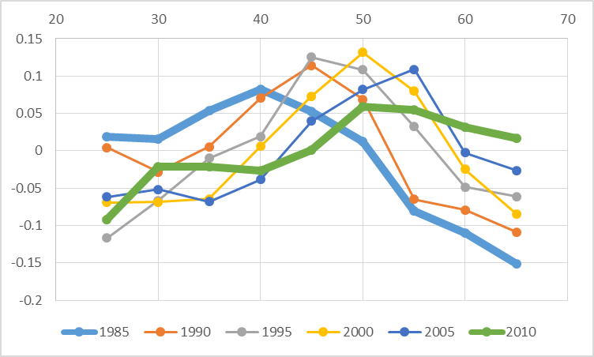
a. Relative(?) socio-economic decline
France
Lis 1985-2010
Log level of living (=disposable income per CU)
by age group (0= year average)
age
1980
2010

Slide 17
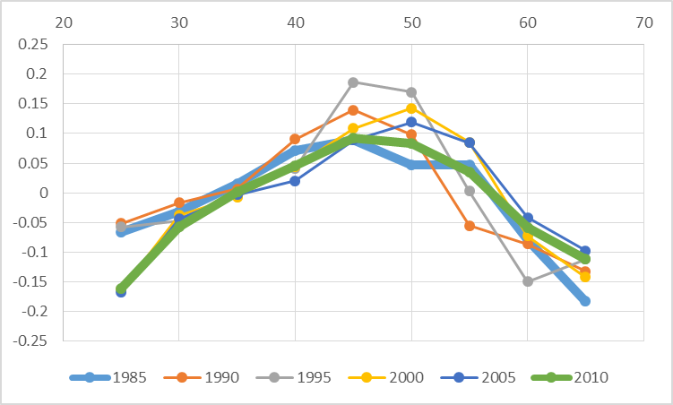
a. Relative(?) socio-economic decline
Germany
Lis 1985-2010
Log level of living (=disposable income per CU)
by age group (0= year average)
age
1980
2010

Slide 18
a. Relative(?) socio-economic decline
real housing price index (dotted lines) and real household incomes index
Housing index
Wages
year
Note: y-axis: Housing index and household incomes adjusted for inflation, indexed to year 2000 (y=100).
Source: International House Price Database, Federal Reserve Bank of Dallas. Mack and Martínez-García (2011).

Slide 19
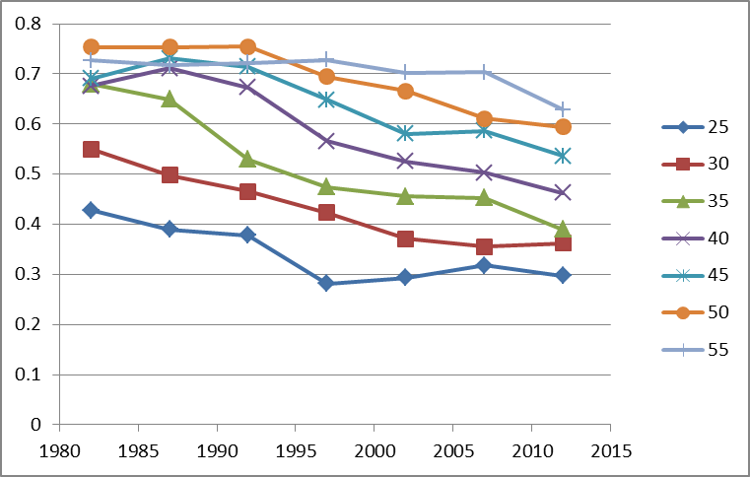
b. Overeducation and educational déclassés
Educational inflation
% of GED (‘bac’) (no more no less)
holders accessing middle class jobs (service cl h+l) 1970-2012
Age
Year
French labor force surveys 1970-2012

Slide 20
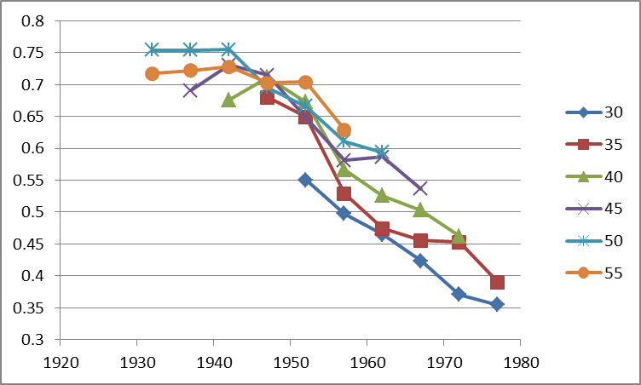
b. Overeducation and educational déclassés
Educational inflation
% of GED (‘bac’) (no more no less)
holders accessing middle class jobs (service cl h+l) 1970-2012
Age
Birth cohort
French labor force surveys 1970-2012

Slide 21
First conclusions:
“As happy as God in France?”
(Hypothesis might be true(?) But avoid generalization to the young plz.)
Interpreting the French case:
    Esping-Andersen Typology of Welfare states:
    France = “corporatist-conservative” welfare regime, stabilization of social relations
    Protection of insiders (protected male workers) against outsiders
    In case of economic brake :
    « Insiderisation » of insiders, already in the stable labor force
    and « outsiderisation » of new entrants
    In France, young people can wait … decades
    Job seeking = Musical chairs game
    Increasing poverty rates for young people, stable intracohort inequalities
    (after taxes and welfare reallocations)
Strong problem of social welfare sustainability:
Those who pay might experience the collapse of this regime…
Notes:
Louis

Slide 22
inequality across birth cohorts
PART 2:
Comparing cohort inequalities
Louis Chauvel
Pr Dr at University of Luxembourg
louis.chauvel@uni.lu
http://www.louischauvel.org
IRSEI
Institute for Research
on Socio-Economic
Inequality

Slide 23
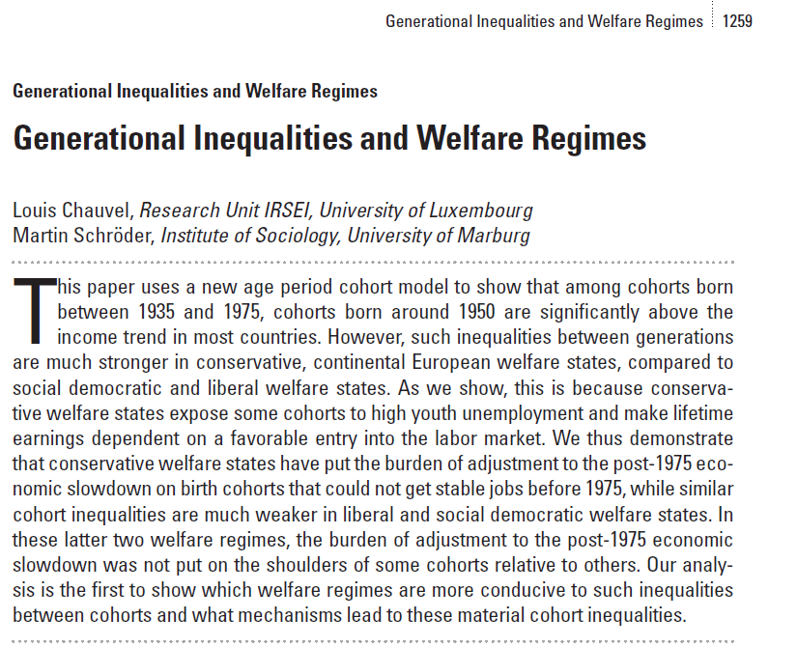

  Backgrounds …
A 17 countries comparison of inter-cohort inequalities

Slide 24
Émile Durkheim (1897),
Le suicide. Étude de sociologie, p.1
Interpreting the French case:
    Esping-Andersen Typology of Welfare states:
    France = “corporatist-conservative” welfare regime, stabilization of social relations
    Protection of insiders (protected male workers) against outsiders
    In case of economic brake :
    « Insiderisation » of insiders, already in the stable labor force
    and « outsiderisation » of new entrants
    In France, young people can wait … decades
    Increasing poverty rates for young people, stable intracohort inequalities
    (after taxes and welfare reallocations)
Emile Durkheim’s Suicide

Slide 25


  Theories of Welfare Regimes
  Decommodification models and welfare regimes
“De-commodification occurs when a service is rendered as a matter of right, and when a person can maintain a livelihood without reliance on the market” (Esping-Anderson, pp. 21-22)
Gosta Esping-Andersen (Danish, born 1947)
Professor @ Universitat Pompeu Fabra (Barcelona).

Slide 26


  Central references
  Pierson Ch. and Castles F.G. (eds) 2006,
  The Welfare State Reader, 2nd ed, Cambridge: Polity Press.
Pierson C., Obinger H., Lewis J., Leibfried S., Castles F.G. (Eds), 2010,
The Oxford Handbook of the Welfare State, Oxford ; Ox Univ Pr.

Slide 27

  Central references
  Schröder, Martin, 2013:
  Integrating Varieties of
  Capitalism and Welfare State Research:
  A Unified Typology of Capitalisms.
  New York: Palgrave.

Slide 28
 | Liberal (=Residual) Theoretical equality of opportunity | Corporatist (=Conservative) Maintaining social order | Social-demo. (=Universalistic) decommodification defamilialistion destartification
Degree / Model of decommodification | Free Market as the central institution | Intermediate level of decommo-dification | Collective social consumption promoted
System of social stratification | Protection of the (good) poor, but stigmatization of “free riders”: Strong economic inequalities but more permeable boundaries between social classes | Solidarity between equals: Intermediate degree of inequality but social boundaries strongly impermeable | Economic, gender, inequality is minimal and strong “fluidity” (net mobility, equality of opportunities & outcomes) between classes
Typical countries | US UK | Germany (France) | Sweden

Slide 29
Three (+1) modalities Esping-Andersen Typology of Welfare states :
    Conservative model (Continental Europe) : FRANCE
    Preservation of (old) social balance, with social insurance excluding unemployed => strong intercohort inequalities and less intracohort inequalities than in the Liberal model
    <Familialistic Model (Mediterranean Europe) : ITALY>
    <Conservative + family and local and clientelistic solidarities>
    Liberal model : (Anglo-saxon world) : US
    Market as a central institution, residual welfare state against market failures
    HL0 : more intracohort inequalities
    HL1 : less intercohort inequality (competition between generations)
    « Social-democrat » Model (Nordic Europe) : DENMARK
    Citizenship and broad participation to discussions and bargaining around social reforms between social groups (gender, generations, etc.) for a long-term development
    HD0 : less intracohort inequalities
    HD1 : residual intercohort inequalities (positive compromise between generations)

Slide 30
Methodology I : the base ➔ A = P – C
BUT ! How to distinguish durable scarring effects and fads ???
Hysteresis = stability versus Resilience = resorption of scars

Slide 31
Statistical background: Age Period Cohort models
Separate the effects of age, period of measurement and cohort.
Problematic colinearity:
cohort (date of birth) = period (date of measurement) - age
(Ryder 1965, Mason et al. 1973, Mason / Fienberg 1985, Mason / Smith 1985,
Yang Yang et al. 2006 2008, Smith 2008, Pampel 2012)
Notes:
Louis

Slide 32

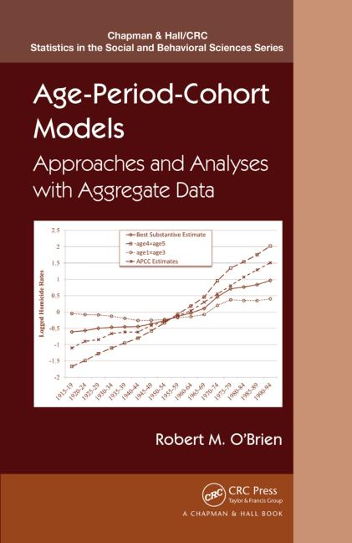
Remember Whelpton and Frost
APC literature: Gospels & Bibles 1970-1990s
MASON K. O., MASON W. M., WINSBOROUGH H. H., POOLE K., 1973, “Some methodological issues in cohort analysis of archival data”, American sociological review, 38, pp. 242-258.
GLENN N. D., 1976, “Cohort analysts’ futile quest : statistical attempts to separate age, period, and cohort effects”, American sociological review, 41, pp. 900-905.
Adams, J. 1978. “Sequential Strategies and the Separation of Age, Cohort, and Time-of-Measurement Contributions to Developmental Data.” Psychological Bulletin 85: 1309-16.
HASTINGS D. W., BERRY L. G., 1979, Cohort analysis : a collection of interdisciplinary readings, Oxford (Ohio), Scripps Foundation for Research in Population Problems.
Rodgers, W.L. 1982. “Estimable Functions of Age, Period, and Cohort Effects.” American Sociological Review 47:774-87.
Holford, T.R. 1983. “The Estimation of Age, Period, and Cohort Effects for Vital Rates.” Biometrics 39:311-24.
Mason W.M. and H.L. Smith. 1985. “Age-Period-Cohort Analysis and the Study of Deaths from Pulmonary Tuberculosis.” Pp.151-228 in Cohort Analysis in Social Research: Beyond the Identification Problem, edited by W.M. Mason and S.E. Fienberg. New York: Springer-Verlag.
MASON W. M., FIENBERG S. E., 1985, Cohort analysis in social research : beyond the identification problem, Berlin, Springer Verlag.
Clayton, D. and E. Schifflers. 1987a. “Models for Temporal Variation in Cancer Rates I: Age-Period and Age-Cohort Models.” Statistics in Medicine 6:449-67.
Clayton, D. and E. Schifflers. 1987b. “Models for Temporal Variation in Cancer Rates II: Age-Period-Cohort Models.” Statistics in Medicine 6:468-81.
Hout M. and A.M. Greeley, 1989, “The Cohort Doesn't Hold: Comment on Chaves”, Journal for the Scientific Study of Religion, n. 29, pp.519-524.
WILMOTH J. R., 1990, “Variation in vital rates by age, period, and cohort”, in C. C. Clogg (ed.), Sociological methodology, Oxford, Basil Blackwell, vol. 20, pp. 295-335.
WILMOTH J. R., 2001, “Les modèles âge-période-cohorte en démographie”, in G. CASELLI, J. VALLIN, G. WUNSCH (eds.), Démographie : analyse et synthèse. I : La dynamique des populations, Paris, Ined, pp. 379-397.

Slide 33
APC literature 2008-2013
Yang, Y. and Land, K.C. (2008). Age–period–cohort analysis of repeated cross-section surveys. Fixed or random effects? Sociological Methods & Research 36(3):297–326.
Smith, H.L. (2008). “Advances in Age-Period-Cohort Analysis.” Sociological Methods & Research 36-3:287-96.
Yang Y., Schulhofer-Wohl, S., Fu, W. and Land, K. (2008). “The Intrinsic Estimator for Age-Period-Cohort Analysis: What It is and How to Use it?” American Journal of Sociology, 113:1697-1736.
O’Brien, R.M. 2011a. “Constrained Estimators and Age-Period-Cohort Models.” Sociological Methods & Research 40:419-52.
Hui Zheng, Yang Yang and Kenneth C. Land, 2011, Variance Function Regression in Hierarchical Age-Period-Cohort Models: Applications to the Study of Self-Reported Health, Am Sociol Rev. 2011 December; 76(6): 955–983.
Wilson, J.A., Zozula, C. and Gove, W.R. (2011). Age, Period, Cohort and Educational Attainment: The Importance of Considering Gender. Social Science Research 40:136-49.
Pampel, F.C. and Hunter, L.M. (2012). Cohort Change, Diffusion, and Support for Environmental Spending in the United States. American journal of sociology 118(2):420-448.
Campbell Colin, Jessica Pearlman (2013), Period effects, cohort effects, and the narrowing gender wage gap, Social Science Research, Volume 42, Issue 6, p.1693–1711
Yang Y. and Land, K.C. (2013), Age-period-cohort analysis. New models, methods, and empirical applications. CRC Press, Taylor & Francis Group, Boka Raton, FL
Fienberg, S. E. (2013). Cohort analysis’ unholy quest: A discussion. Demography, 50, 1981–1984.
Luo, L. (2013). Assessing Validity and Application Scope of the Intrinsic Estimator Approach to the Age-Period-Cohort Problem. Demography 50(6):1945-67.
Dassonneville, R. (2013). Questioning generational replacement. An age, period and cohort analysis of electoral volatility in the Netherlands, 1971–2010. Electoral Studies 32(1):37-47

Slide 34
APC literature (2014-2015)
Grasso, M.T. (2014). Age, Period and Cohort Analysis in a Comparative Context: Political Generations and Political Participation Repertoires in Western Europe. Electoral Studies, 33:63–76.
Chancel L. (2014). Are Younger Generations Higher Carbon Emitters than their Elders?: Inequalities, Generations and CO2 Emissions in France and in the USA. Ecological Economics, 100:195–207.
Phillips, J. A. (2014). A changing epidemiology of suicide? The influence of birth cohorts on suicide rates in the United States. Social Science & Medicine, 114, 151-160.
Schwadel, P. and Garneau, C. R. H. (2014), An Age–Period–Cohort Analysis of Political Tolerance in the United States. The Sociological Quarterly, 55: 421–452
Chauvel, L. and Schröder M., (2014). Generational inequalities and welfare regimes. Social forces 92 (4):1259-1283.
Chauvel, L. and Smits F.. (2015). The endless baby-boomer generation: Cohort differences in participation in political discussions in nine European countries in the period 1976-2008. In: European Societies.
Reither, E. N., Masters, R. K., Yang, Y. C., Powers, D. A., Zheng, H., & Land, K. C. (2015). Should age-period-cohort studies return to the methodologies of the 1970s? Social Science & Medicine.
Harper S. Invited commentary: A-P-C . . . It’s easy as 1-2-3! Am J Epidemiol. 2015 online publication
O’Brien RM, 2015, Model Misspecification when Eliminating a Factor in Age-Period-Cohort Models, ASA 2015 Chicago mimeo.

Slide 35
APC literature (2015-2017)
Chauvel, L. and M. Schröder. 2015. The impact of cohort membership on disposable incomes in West Germany, France, and the United States. European Sociological Review, 31:298-311.
Reither, E. N., Masters, R. K., Yang, Y. C., Powers, D. A., Zheng, H., & Land, K. C. (2015). Should age-period-cohort studies return to the methodologies of the 1970s? Social Science & Medicine.
Harper S. Invited commentary: A-P-C . . . It’s easy as 1-2-3! Am J Epidemiol. 2015 online publication
Lindahl-Jacobsen, R., Rau, R., Jeune, B., Canudas-Romo, V., Lenart, A., Christensen, K., & Vaupel, J. W. (2016). Rise, stagnation, and rise of Danish women’s life expectancy. Proceedings of the National Academy of Sciences, 113(15), 4015-4020.
Chauvel, L., Leist, A. K., & Smith, H. L. (2016). Cohort factors impinging on suicide rates in the United States, 1990-2010. Annual Meeting of the Population Association of America, March 31 - April 2, 2016, Washington, DC. Full paper available at http://orbilu.uni.lu/handle/10993/25339.
Chauvel L, Leist AK, Ponomarenko V (2016) Testing Persistence of Cohort Effects in the Epidemiology of Suicide: an Age-Period-Cohort Hysteresis Model.
PLoS ONE 11(7): e0158538. doi:10.1371/journal.pone.0158538
Bell, A. and K. Jones. 2017. The hierarchical age–period–cohort model: Why does it find the results that it finds? Quality & Quantity: 1-17.

Slide 36
Our method A: APCD
APCD (detrended): are some cohorts above or below a linear trend of long-run economic growth? Basically, the APCD is a ‘bump detector’.
STATA ssc install apcd
=> available ado file
PLZ see more on www.louischauvel.org/apcdex.htm
Notes:
Louis

Slide 37
4. Data
Dependent variable
We want to explain the living standards of members of different cohorts:
Variable “dpi” (disposable income) from the Luxembourg Income Study.
Logged and divided by the square root of household members and adjusted for inflation: reflects household-equalized real disposable income after taxes and transfers.
Independent variables
Age, Period of measurement, Cohort-membership of respondent (date of birth).
Plus controls for:
education (ISCED code), sex, partner in household, # of children, immigrant-status.
Main interest
How much does the mere date of birth (cohort membership) influence living standards? – in terms of deviation from the linear trend
Notes:
Martin

Slide 38
clear all
capture ssc install apcd
set linesize 100
gen d3=.
foreach gogo in fr it no us {
qui {
if "`gogo'"== "fr" local fifi " fr84 fr89 fr94 fr00 fr05 "
if "`gogo'"== "it" local fifi " it86 it91 it95 it00 it04 "
if "`gogo'"== "no" local fifi "no86 no91 no95 no00 no04 "
if "`gogo'"== "us" local fifi "us86 us91 us94 us00 us04 "
foreach toto in `fifi' {
local perso "$`toto'p"
local house "$`toto'h"
qui use hid ppopwgt age sex relation educ nchildren immigr educ_c pi deflat partner pmi ptime using `perso' , clear
qui joinby hid using `house'
keep hid ppopwgt age sex relation educ pi deflat year iso2 hpopwgt dpi ///
deflator nchildren immigr educ_c hmi hmx* npers partner pmi ptime
local save "t`toto'"
qui save `save' , replace
}
clear all
foreach toto in `fifi' {
local save "t`toto'"
qui append using `save'
}
qui recode year (1977/1982=1980) (1983/1987=1985) (1988/1992=1990) (1993/1997=1995) (1998/2002=2000) (2003/2008=2005)
qui gen age5=int((age-3)/5)*5+3
qui gen pweight = int(ppop)
qui keep if age >= 20 & age < 65
gen page=floor(age/5)*5
keep if (page >= 25 & page <= 64)
gen year5=year
replace year =int((year-1980)/5)
gen educ2=int(educ)
}
di "`gogo'"
gen ldpi=ln(dpi/sqrt(npers))
keep if age5>=25 & age5<60
xi: apcd ldpi [pw= pweight] if year5>=1985 & age5>=25 & age5<60 , age(page) period(year5)
}

Slide 39
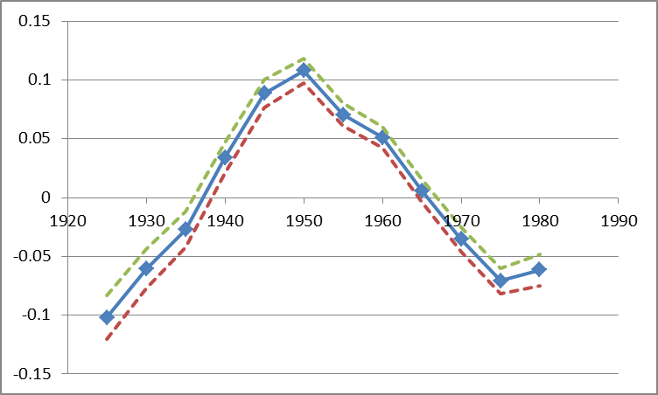
France : APCD (detrended) cohort coefficient of disposable per uc income
cohorts
controls for:
education (ISCED code), sex, partner in household, # of children, immigrant-status.
Luxembourg Income Study microdata – 1980s to 2010s
Notes:
Martin
These figures show: how much different cohorts (people with different dates of birth) are below or above the long-run trend of economic growth, before and after controls are introduced.
Germany: Fortunate cohorts can have a living standards around 8 percent above of what one would expect when every cohort‘s income would have been proportionate with general trends of economic growth. But much of this is due to their better education etc. After this is controlled, only the cohorts born around 1945/50 are about 5 percent above the trend.
France: Fortunate cohort‘s living standard about 10 percent above the trend, unfortunate ones almost 10 percent below it. Even worse after controls are introduced (right side).
US: cohort‘s living standard does not diverge very much from the trend.
But how does this compare when set in relation to overall increases in living standards? APCT

Slide 40
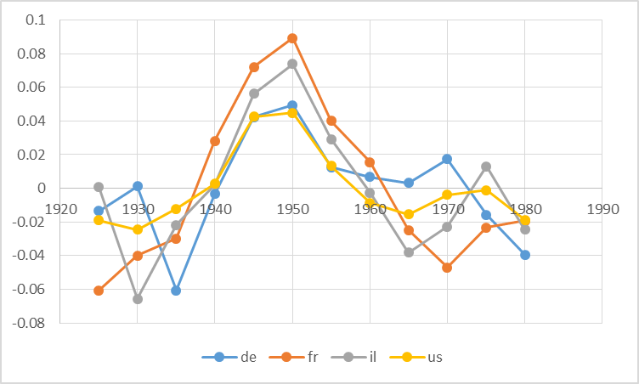
APCD (detrended) cohort coefficient of disposable per uc income, no control
Luxembourg Income Study microdata – 1980s to 2010s
Notes:
Martin
These figures show: how much different cohorts (people with different dates of birth) are below or above the long-run trend of economic growth, before and after controls are introduced.
Germany: Fortunate cohorts can have a living standards around 8 percent above of what one would expect when every cohort‘s income would have been proportionate with general trends of economic growth. But much of this is due to their better education etc. After this is controlled, only the cohorts born around 1945/50 are about 5 percent above the trend.
France: Fortunate cohort‘s living standard about 10 percent above the trend, unfortunate ones almost 10 percent below it. Even worse after controls are introduced (right side).
US: cohort‘s living standard does not diverge very much from the trend.
But how does this compare when set in relation to overall increases in living standards? APCT

Slide 41
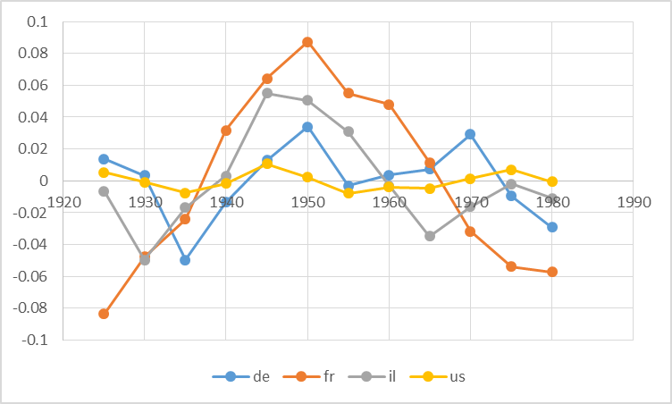
APCD (detrended) cohort coefficient of disposable per uc income, w controls
controls : education (ISCED code), sex, partner in household, # of children
Luxembourg Income Study microdata – 1980s to 2010s
Notes:
Martin
These figures show: how much different cohorts (people with different dates of birth) are below or above the long-run trend of economic growth, before and after controls are introduced.
Germany: Fortunate cohorts can have a living standards around 8 percent above of what one would expect when every cohort‘s income would have been proportionate with general trends of economic growth. But much of this is due to their better education etc. After this is controlled, only the cohorts born around 1945/50 are about 5 percent above the trend.
France: Fortunate cohort‘s living standard about 10 percent above the trend, unfortunate ones almost 10 percent below it. Even worse after controls are introduced (right side).
US: cohort‘s living standard does not diverge very much from the trend.
But how does this compare when set in relation to overall increases in living standards? APCT

Slide 42
APCD (detrended) cohort coefficient of disposable per uc income, w controls
controls : education (ISCED code), sex, partner in household, # of children, immigrant-status.
ca de dk es
fi fr il it
nl no uk us
Luxembourg Income Study microdata – 1980s to 2010s
Notes:
Martin
These figures show: how much different cohorts (people with different dates of birth) are below or above the long-run trend of economic growth, before and after controls are introduced.
Germany: Fortunate cohorts can have a living standards around 8 percent above of what one would expect when every cohort‘s income would have been proportionate with general trends of economic growth. But much of this is due to their better education etc. After this is controlled, only the cohorts born around 1945/50 are about 5 percent above the trend.
France: Fortunate cohort‘s living standard about 10 percent above the trend, unfortunate ones almost 10 percent below it. Even worse after controls are introduced (right side).
US: cohort‘s living standard does not diverge very much from the trend.
But how does this compare when set in relation to overall increases in living standards? APCT

Slide 43
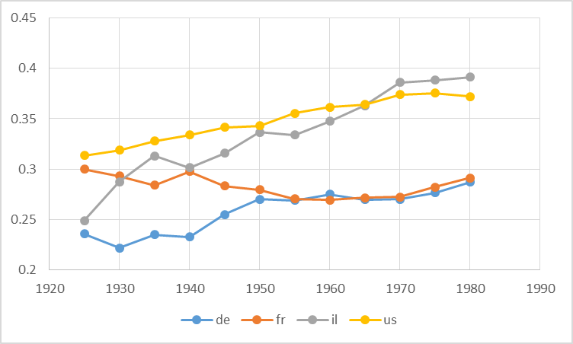
APCT (trended) cohort coefficient of Gini indexes

Slide 44
APCT (trended) cohort coefficient of Gini indexes
Notes:
Martin
These figures show: how much different cohorts (people with different dates of birth) are below or above the long-run trend of economic growth, before and after controls are introduced.
Germany: Fortunate cohorts can have a living standards around 8 percent above of what one would expect when every cohort‘s income would have been proportionate with general trends of economic growth. But much of this is due to their better education etc. After this is controlled, only the cohorts born around 1945/50 are about 5 percent above the trend.
France: Fortunate cohort‘s living standard about 10 percent above the trend, unfortunate ones almost 10 percent below it. Even worse after controls are introduced (right side).
US: cohort‘s living standard does not diverge very much from the trend.
But how does this compare when set in relation to overall increases in living standards? APCT

Slide 45
Conclusion
France is a very problematic case of young cohort economic slowdown
Italy, Spain, share very similar problems
=> there, the young get worse and the new seniors get relatively better
Reason: In conservative welfare state, the protection of insiders (the old) against outsiders (the young) produces strong difficulties in case of eco slow down, and then massive scarring effects
US not so bad? See closer in the details = suicide rates in the US!!!
See full paper here :
https://paa.confex.com/paa/2016/meetingapp.cgi/Paper/6950
Notes:
Louis
Controlling for education, household composition, immigration status etc, we find that French cohorts born very early or late or strongly disadvantaged.
Unsurprising for pre-1930 cohorts in France: E.g. entering the working market in 1940 is not a great moment to enter the working market. But more disquieting is our finding about cohorts that have been born recently.

